Slide 1
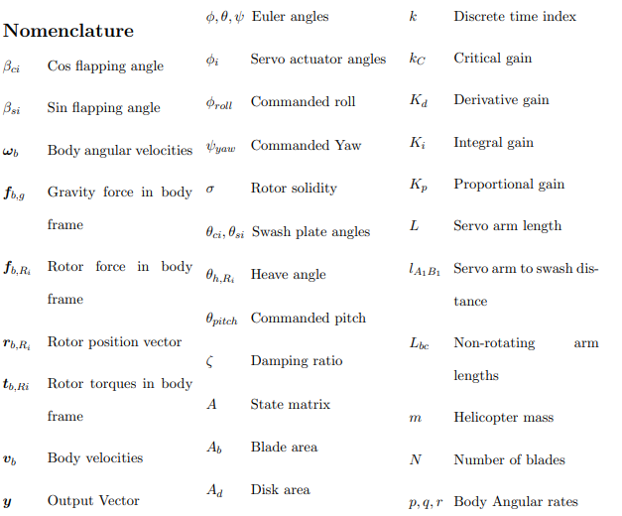
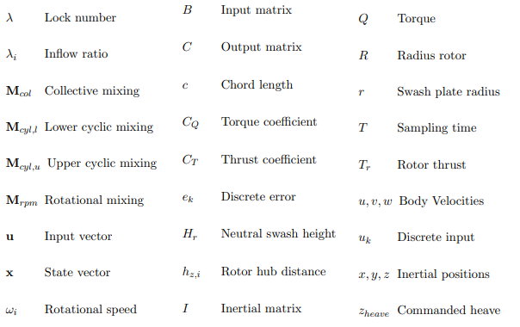
Jansens Nomenclature

Slide 2
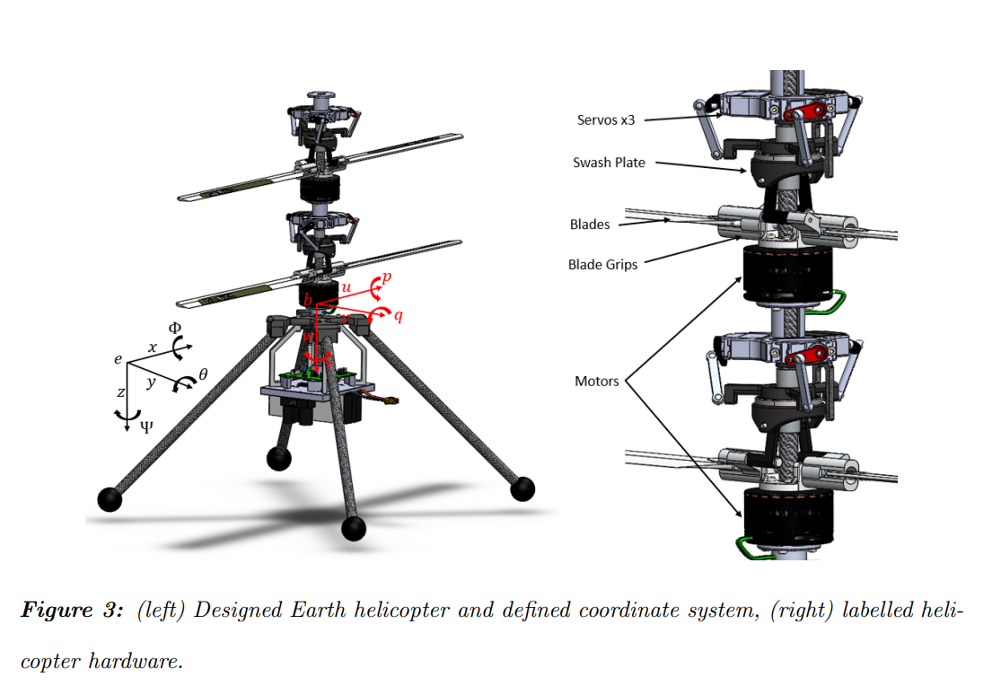
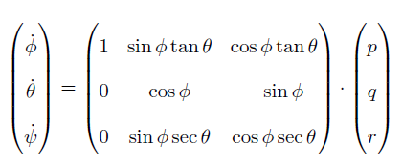
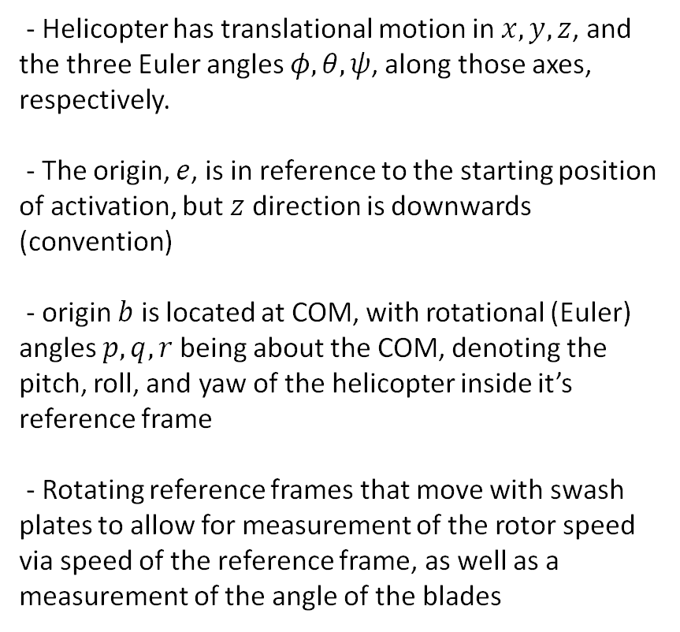
Helicopter Translational and Rotational Dynamics
- Helicopter has translational motion in $x,y,z$, and the three Euler angles $φ,θ,ψ$, along those axes, respectively.
- The origin, $e$, is in reference to the starting position of activation, but $z$ direction is downwards (convention)
- origin $b$ is located at COM, with rotational (Euler) angles $p,q,r$ being about the COM, denoting the pitch, roll, and yaw of the helicopter inside it’s reference frame
- Rotating reference frames that move with swash plates to allow for measurement of the rotor speed via speed of the reference frame, as well as a measurement of the angle of the blades

Slide 3
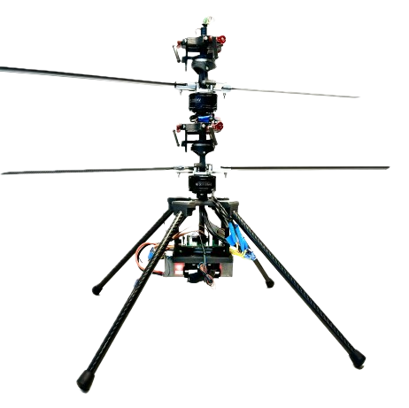










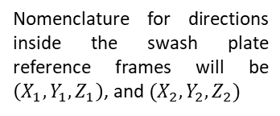













Frames of Reference
Nomenclature for directions inside the swash plate reference frames will be $\left(X_{1},Y_{1},Z_{1}\right)$, and $(X_{2},Y_{2},Z_{2})$
$$O_{3}$$
$$Φ_{1}$$
$$Θ_{1}$$
Heave Angle
$$O_{1}$$
$$p$$
$$x′$$
$$Ψ_{1}$$
$$q$$
Rotor Spacing
$$y′$$
$$w$$
$$\underline{r}$$
$$z′$$
$$O_{4}$$
$$Φ_{2}$$
Heave Angle
$$Θ_{2}$$
$$O_{0}$$
$$φ$$
$$x$$
$$Ψ_{2}$$
$$θ$$
$$y$$
$$ψ$$
$$z$$
Notes:
Note that $O_{1}$, $O_{2}$, and $O_{3}$ are all the same axes, but offset by different vertical offsets in the $z′$ direction. These axes all rotate with each other, with $Z_{1}$ and $Z_{2}$ being fixed along the axial direction of the shaft

Slide 4


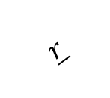



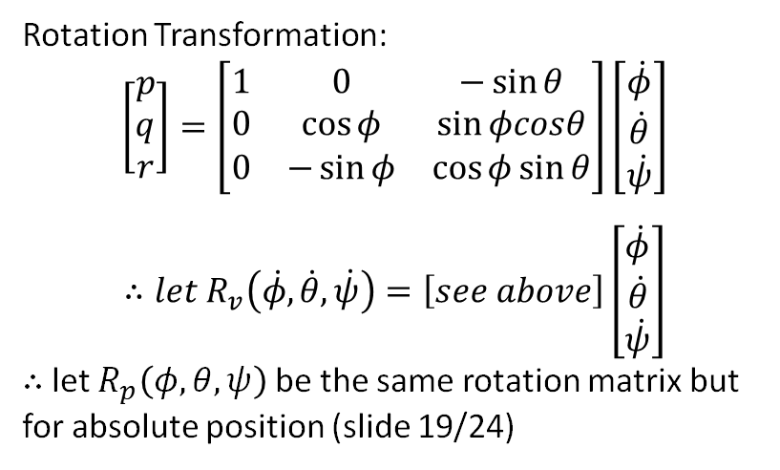



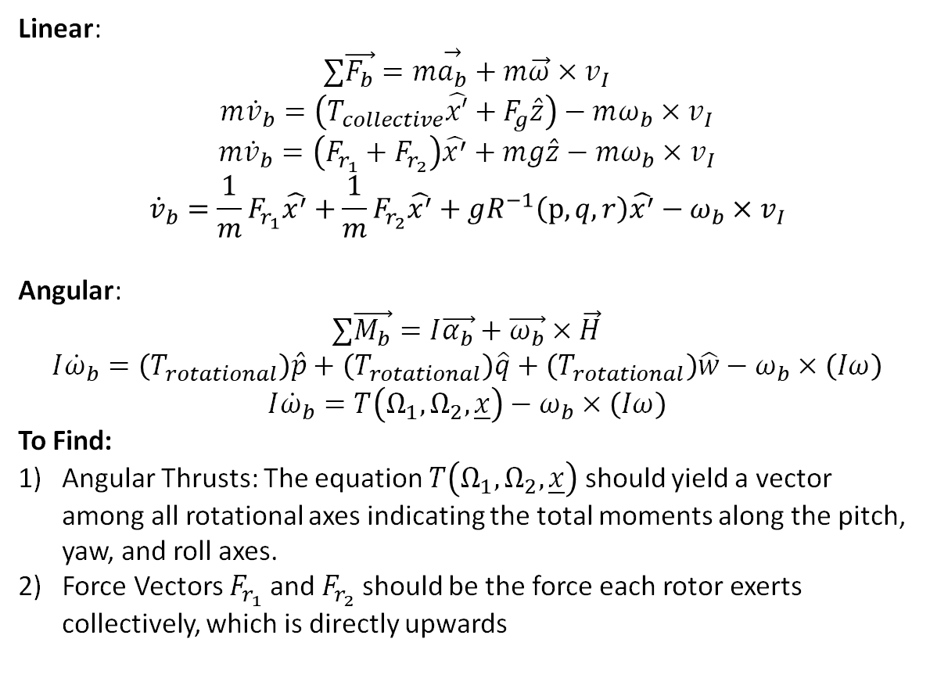

Equations of Motion
$$O_{1}$$
$$p$$
$$x′$$
Linear:
$$∑\vec{F_{b}}=m\overset{→}{a_{b}}+m\vec{ω}×v_{I}$$
$$m{\dot{v}}_{b}=\left(T_{collective}\hat{x′}+F_{g}\hat{z}\right)−mω_{b}×v_{I}$$
$$m{\dot{v}}_{b}=\left(F_{r_{1}}+F_{r_{2}}\right)\hat{x^{′}}+mg\hat{z}−{mω}_{b}×v_{I}$$
$${\dot{v}}_{b}=\frac{1}{m}F_{r_{1}}\hat{x^{′}}+\frac{1}{m}F_{r_{2}}\hat{x^{′}}+gR^{−1}\left(p,q,r\right)\hat{x^{′}}−ω_{b}×v_{I}$$
Angular:
$$∑\vec{M_{b}}=I\vec{α_{b}}+\vec{ω_{b}}×\vec{H}$$
$$I{\dot{ω}}_{b}=\left(T_{rotational}\right)\hat{p}+\left(T_{rotational}\right)\hat{q}+\left(T_{rotational}\right)\hat{w}−ω_{b}×\left(Iω\right)$$
$$I{\dot{ω}}_{b}=T\left(Ω_{1},Ω_{2},\underline{x}\right)−ω_{b}×\left(Iω\right)$$
To Find:
Angular Thrusts: The equation $T\left(Ω_{1},Ω_{2},\underline{x}\right)$ should yield a vector among all rotational axes indicating the total moments along the pitch, yaw, and roll axes.
Force Vectors $F_{r_{1}}$ and $F_{r_{2}}$ should be the force each rotor exerts collectively, which is directly upwards
$$q$$
$$y′$$
$$w$$
$$\underline{r}$$
$$O_{0}$$
$$φ$$
$$z′$$
$$x$$
$$θ$$
$$y$$
$$ψ$$
$$z$$
Rotation Transformation:
$$\left[\begin{matrix}p \\ q \\ r\end{matrix}\right]=\left[\begin{matrix}1 & 0 & −\sin{θ} \\ 0 & \cos{φ} & \sin{φcosθ} \\ 0 & −\sin{φ} & \cos{φ\sin{θ}}\end{matrix}\right]\left[\begin{matrix}\dot{φ} \\ \dot{θ} \\ \dot{ψ}\end{matrix}\right]$$
$$∴let R_{v}\left(\dot{φ},\dot{θ},\dot{ψ}\right)=\left[see above\right]\left[\begin{matrix}\dot{φ} \\ \dot{θ} \\ \dot{ψ}\end{matrix}\right]$$
$∴$ let $R_{p}\left(φ,θ,ψ\right)$ be the same rotation matrix but for absolute position (slide 19/24)

Slide 5
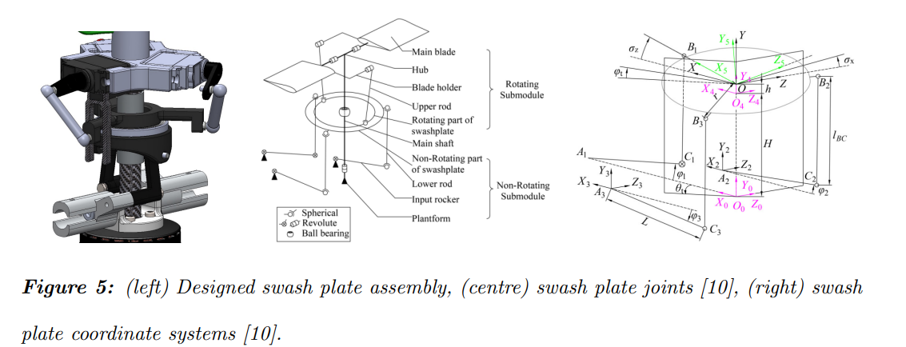
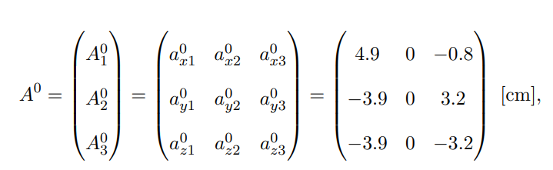
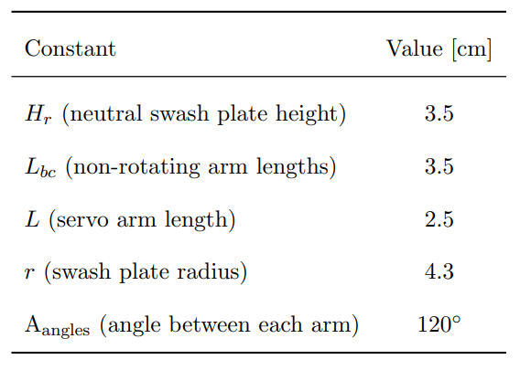
Swash Plate Dynamics
Three Principle angles, $θ_{h},θ_{c},θ_{s}$

Slide 6









Free Body Diagram
$$shown in red is origin O_{1}$$
$${−F}_{Tc}\hat{z′}$$
$$x′$$
$$φ$$
$$θ$$
$$y′$$
$$Ψ$$
$$z′$$
$$F_{g}\hat{z}$$

Slide 7






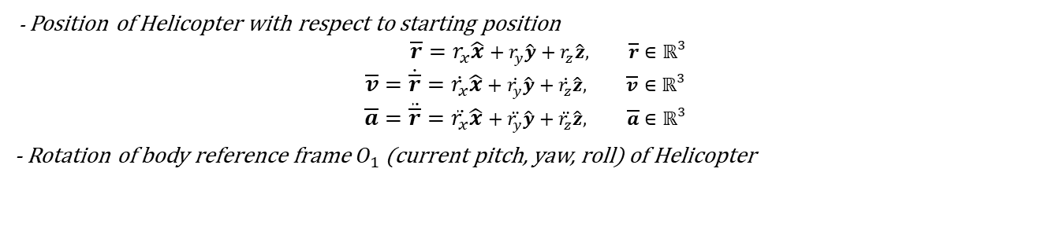

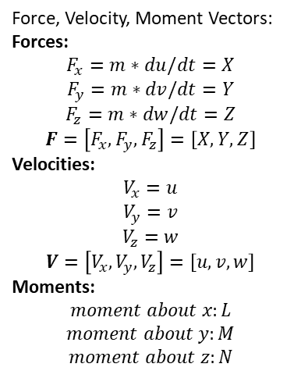
Frames of Reference
$$O_{1}$$
Translational position (& Derivatives) of Body Reference Frame ($O_{1}$) Relative to the Inertial Reference Frame ($O_{0}$)
$$p$$
$$x′$$
- Position of Helicopter with respect to starting position
$$\overline{r}=r_{x}\hat{x}+r_{y}\hat{y}+r_{z}\hat{z}, \overline{r}∈ℝ^{3}$$
$$\overline{v}=\dot{\overline{r}}=\dot{r_{x}}\hat{x}+\dot{r_{y}}\hat{y}+\dot{r_{z}}\hat{z}, \overline{v}∈ℝ^{3}$$
$$\overline{a}=\ddot{\overline{r}}=\ddot{r_{x}}\hat{x}+\ddot{r_{y}}\hat{y}+\ddot{r_{z}}\hat{z}, \overline{a}∈ℝ^{3}$$
- Rotation of body reference frame $O_{1}$ (current pitch, yaw, roll) of Helicopter
$$q$$
$$y′$$
Force, Velocity, Moment Vectors:
Forces:
$$F_{x}=m∗du/dt=X$$
$$F_{y}=m∗dv/dt=Y$$
$$F_{z}=m∗dw/dt=Z$$
$$F=\left[F_{x},F_{y},F_{z}\right]=\left[X,Y,Z\right]$$
Velocities:
$$V_{x}=u$$
$$V_{y}=v$$
$$V_{z}=w$$
$$V=\left[V_{x},V_{y},V_{z}\right]=\left[u,v,w\right]$$
Moments:
$$moment about x:L$$
$$moment about y:M$$
$$moment about z:N$$
$$w$$
Angular Velocity of Helicopter about Helicopter COM ($O_{1}$)
$$z′$$
Coordinate Transforms
- Inertial Frame to Body Frame
$$A=\left[\begin{matrix}\cos{θ}\cos{ψ} & \cos{θ}\cos{ψ} & −\sin{θ} \\ \sin{φ}\sin{θ}\cos{ψ}−\cos{φ}\sin{ψ} & \sin{φ}\sin{θ}\sin{ψ}+\cos{φ}\cos{ψ} & \cos{θ}\sin{ψ} \\ \cos{φ}\sin{θ}\cos{ψ}+\sin{φ}\sin{ψ} & \cos{φ}\sin{θ}\sin{ψ}−\sin{φ}\cos{ψ} & \cos{θ}cosφ\end{matrix}\right], such that \left[\begin{matrix}x′ \\ y′ \\ z′\end{matrix}\right]=A\left[\begin{matrix}x \\ y \\ z\end{matrix}\right]$$

Slide 8
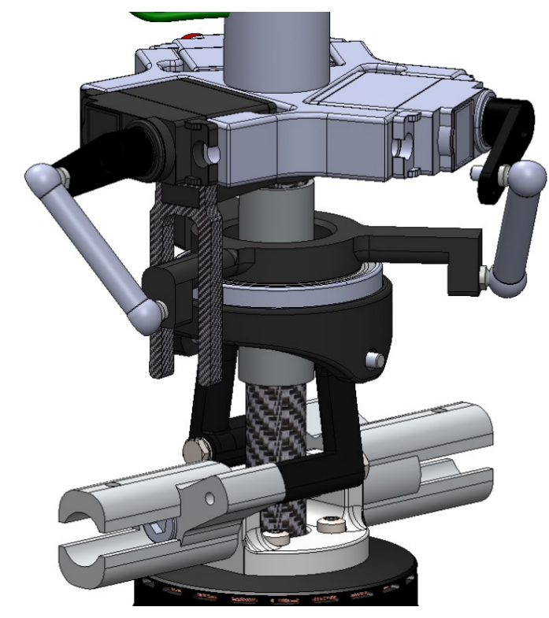
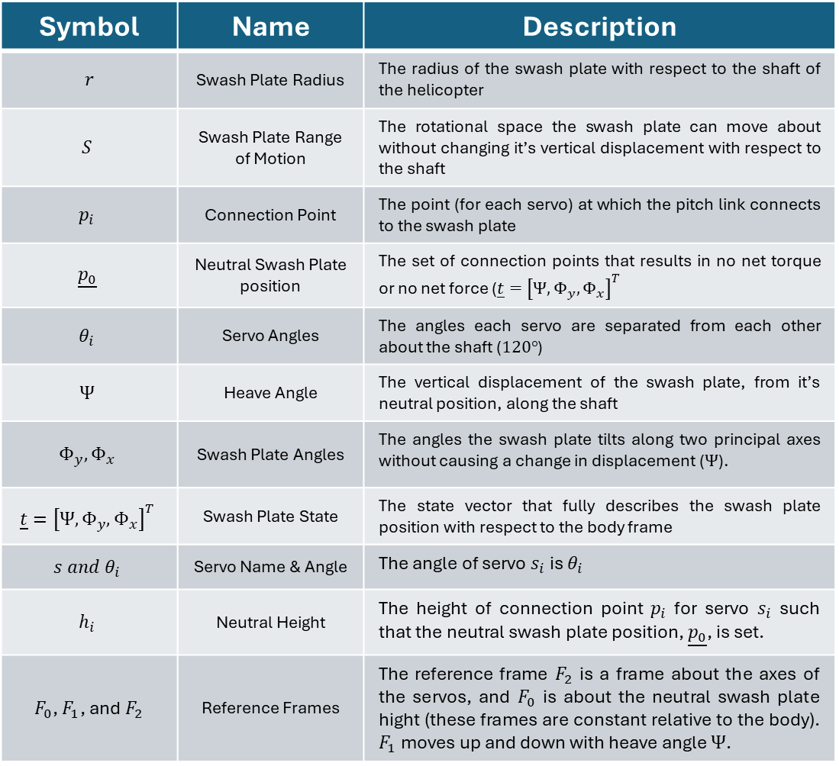
Swash Plate Dynamics
Nomenclature and Definitions
1/11
Symbol | Name | Description
$$r$$ | Swash Plate Radius | The radius of the swash plate with respect to the shaft of the helicopter
$$S$$ | Swash Plate Range of Motion | The rotational space the swash plate can move about without changing it’s vertical displacement with respect to the shaft
$$p_{i}$$ | Connection Point | The point (for each servo) at which the pitch link connects to the swash plate
$$\underline{p_{0}}$$ | Neutral Swash Plate position | The set of connection points that results in no net torque or no net force ($\underline{t}={\left[Ψ, Φ_{y},Φ_{x}\right]}^{T}$
$$θ_{i}$$ | Servo Angles | The angles each servo are separated from each other about the shaft ($120°$)
$$Ψ$$ | Heave Angle | The vertical displacement of the swash plate, from it’s neutral position, along the shaft
$$Φ_{y},Φ_{x}$$ | Swash Plate Angles | The angles the swash plate tilts along two principal axes without causing a change in displacement ($Ψ$).
$$\underline{t}={\left[Ψ,Φ_{y},Φ_{x}\right]}^{T}$$ | Swash Plate State | The state vector that fully describes the swash plate position with respect to the body frame
$$s{ and θ}_{i}$$ | Servo Name & Angle | The angle of servo $s_{i}$ is $θ_{i}$
$$h_{i}$$ | Neutral Height | The height of connection point $p_{i}$ for servo $s_{i}$ such that the neutral swash plate position, $\underline{p_{0}}$, is set.
$F_{0}$, $F_{1}$, and $F_{2}$ | Reference Frames | The reference frame $F_{2}$ is a frame about the axes of the servos, and $F_{0}$ is about the neutral swash plate hight (these frames are constant relative to the body). $F_{1}$ moves up and down with heave angle $Ψ$.
Servo
Rotation-Locking Fork
Servo Arm
Pitch Link
Connection Point
Swash Plate
shaft

Slide 9
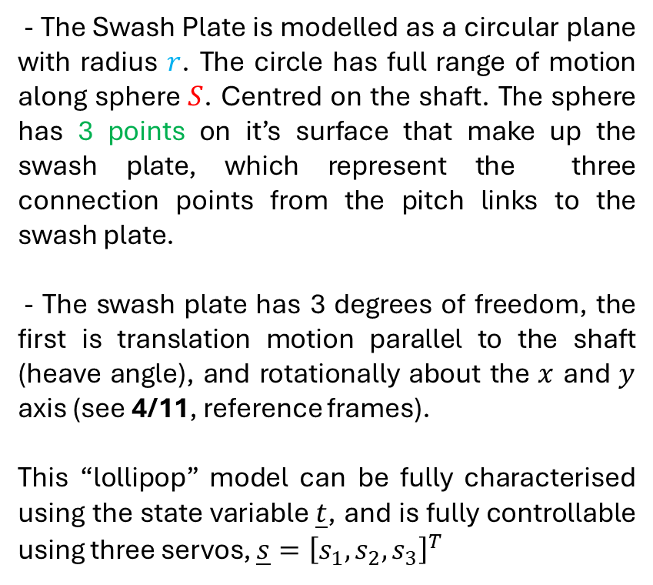



Swash Plate Dynamics
Model
2/11
- The Swash Plate is modelled as a circular plane with radius $r$. The circle has full range of motion along sphere $S$. Centred on the shaft. The sphere has 3 points on it’s surface that make up the swash plate, which represent the three connection points from the pitch links to the swash plate.
- The swash plate has 3 degrees of freedom, the first is translation motion parallel to the shaft (heave angle), and rotationally about the $x$ and $y$ axis (see 4/11, reference frames).
This “lollipop” model can be fully characterised using the state variable $\underline{t}$, and is fully controllable using three servos, $\underline{s}={\left[s_{1},s_{2},s_{3}\right]}^{T}$
r
r
$$p_{3}$$
r
$$p_{1}$$
$$p_{2}$$
S

Slide 10



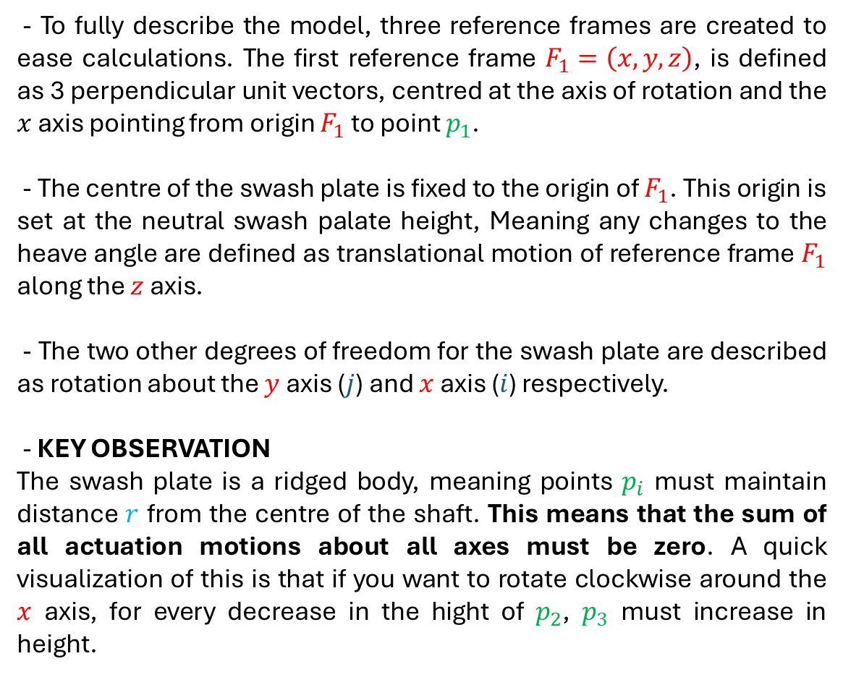
















Swash Plate Dynamics
Reference Frames
$$y$$
3/11
$$j$$
$$p_{2}$$
- To fully describe the model, three reference frames are created to ease calculations. The first reference frame $F_{1}=\left(x,y,z\right)$, is defined as 3 perpendicular unit vectors, centred at the axis of rotation and the $x$ axis pointing from origin $F_{1}$ to point $p_{1}$.
- The centre of the swash plate is fixed to the origin of $F_{1}$. This origin is set at the neutral swash palate height, Meaning any changes to the heave angle are defined as translational motion of reference frame $F_{1}$ along the $z$ axis.
- The two other degrees of freedom for the swash plate are described as rotation about the $y$ axis ($j$) and $x$ axis ($i$) respectively.
- KEY OBSERVATION
The swash plate is a ridged body, meaning points $p_{i}$ must maintain distance $r$ from the centre of the shaft. This means that the sum of all actuation motions about all axes must be zero. A quick visualization of this is that if you want to rotate clockwise around the $x$ axis, for every decrease in the hight of $p_{2}$, $p_{3}$ must increase in height.
r
$$i$$
$$F_{1}$$
r
$$x$$
$$p_{1}$$
r
$$p_{3}$$
$$k$$
$$z$$
$$y$$
$$p_{2}$$
$$z$$
r
$$θ_{3}$$
$$θ_{2}$$
r
$$θ_{1}=0$$
$$x$$
$$F_{1}$$
$$p_{1}$$
r
$$p_{3}$$

Slide 11





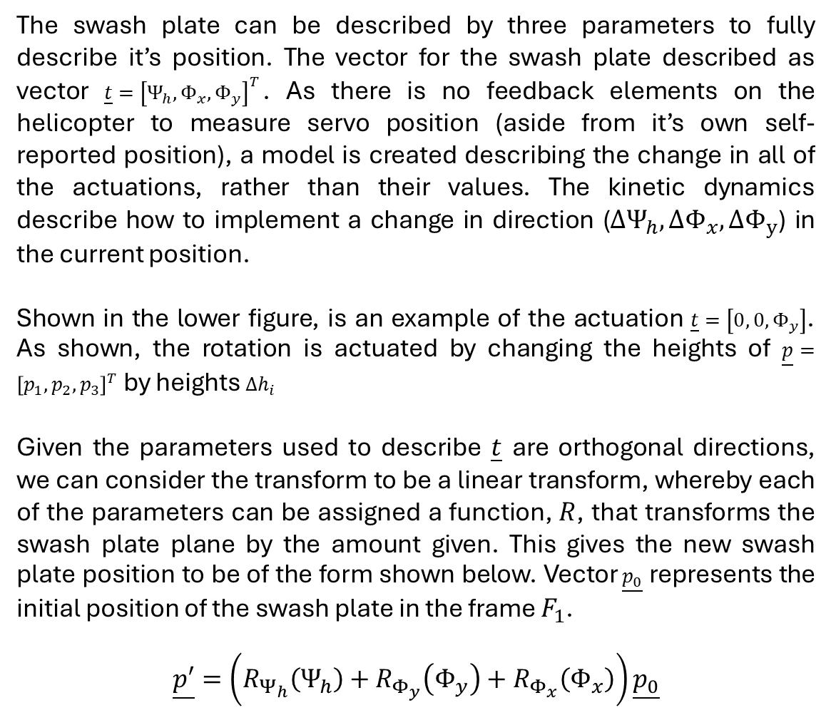



Swash Plate Dynamics
Equations of Motion 1
$$y$$
4/11
$$p_{2}$$
$$z$$
The swash plate can be described by three parameters to fully describe it’s position. The vector for the swash plate described as vector $\underline{t}={\left[Ψ_{h}, Φ_{x},Φ_{y}\right]}^{T}$. As there is no feedback elements on the helicopter to measure servo position (aside from it’s own self-reported position), a model is created describing the change in all of the actuations, rather than their values. The kinetic dynamics describe how to implement a change in direction ($ΔΨ_{h}, ΔΦ_{x},ΔΦ_{y}$) in the current position.
Shown in the lower figure, is an example of the actuation $\underline{t}=\left[0, 0, Φ_{y}\right]$. As shown, the rotation is actuated by changing the heights of $\underline{p}={\left[p_{1}, p_{2}, p_{3}\right]}^{T}$ by heights $Δh_{i}$
Given the parameters used to describe $\underline{t}$ are orthogonal directions, we can consider the transform to be a linear transform, whereby each of the parameters can be assigned a function, $R$, that transforms the swash plate plane by the amount given. This gives the new swash plate position to be of the form shown below. Vector $\underline{p_{0}}$ represents the initial position of the swash plate in the frame $F_{1}$.
$$\underline{p′}=\left(R_{Ψ_{h}}\left(Ψ_{h}\right)+R_{Φ_{y}}\left(Φ_{y}\right)+R_{Φ_{x}}\left(Φ_{x}\right)\right)\underline{p_{0}}$$
r
$$θ_{3}$$
$$θ_{2}$$
r
$$θ_{1}=0$$
$$x$$
$$F_{1}$$
$$p_{1}$$
r
$$p_{3}$$
$$y$$
$$j$$
$$p_{1}$$
$$Δh_{2}$$
$$F_{1}$$
r
$$Δh_{1}$$
r
$$i$$
$$p_{2}$$
$$Φ_{y}$$
$$x$$
r
$$Δh_{3}$$
$$p_{3}$$
$$k$$
$$z$$

Slide 12
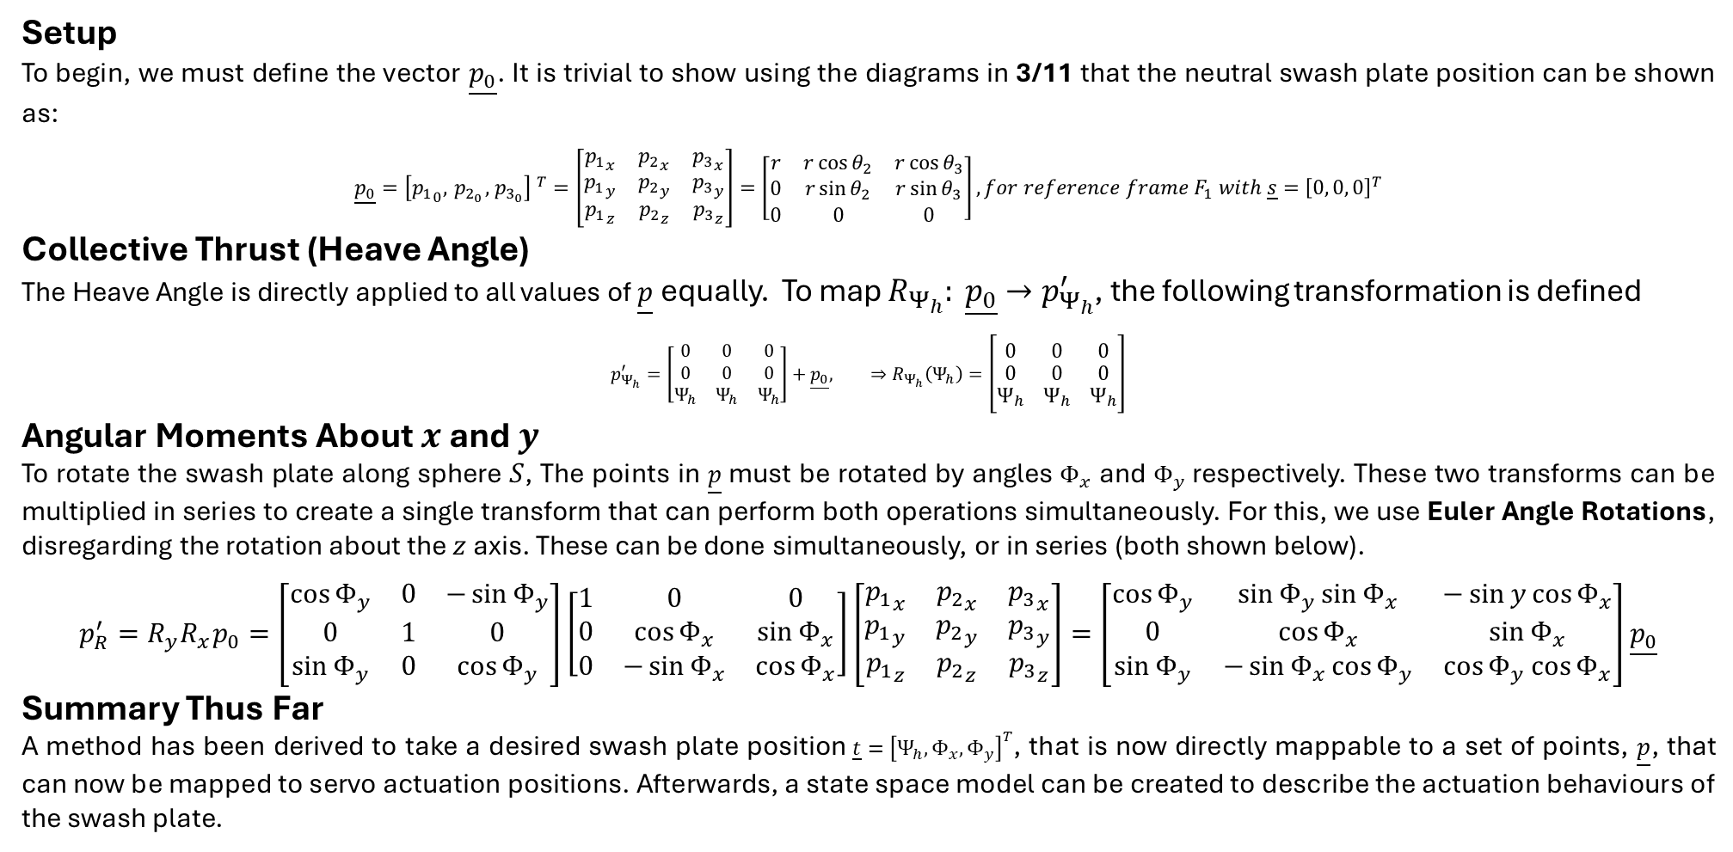
Swash Plate Dynamics
Equations of Motion 2
5/11
Setup
To begin, we must define the vector $\underline{p_{0}}$. It is trivial to show using the diagrams in 3/11 that the neutral swash plate position can be shown as:
$$\underline{p_{0}}={\left[{p_{1}}_{0}, { p}_{2_{0}},{ p}_{3_{0}}\right] }^{T}=\left[\begin{matrix}{p_{1}}_{x} & {p_{2}}_{x} & {p_{3}}_{x} \\ {p_{1}}_{y} & {p_{2}}_{y} & {p_{3}}_{y} \\ {p_{1}}_{z} & {p_{2}}_{z} & {p_{3}}_{z}\end{matrix}\right]=\left[\begin{matrix}r & r\cos{θ_{2}} & r\cos{θ_{3}} \\ 0 & r\sin{θ_{2}} & r\sin{θ_{3}} \\ 0 & 0 & 0\end{matrix}\right], for reference frame F_{1} with \underline{s}={\left[0, 0, 0\right]}^{T}$$
Collective Thrust (Heave Angle)
The Heave Angle is directly applied to all values of $\underline{p}$ equally. To map $R_{Ψ_{h}}: \underline{p_{0}}→p_{Ψ_{h}}^{′}$, the following transformation is defined
$$p_{Ψ_{h}}^{′}=\left[\begin{matrix}0 & 0 & 0 \\ 0 & 0 & 0 \\ Ψ_{h} & Ψ_{h} & Ψ_{h}\end{matrix}\right]+\underline{p_{0}}, ⇒R_{Ψ_{h}}\left(Ψ_{h}\right)=\left[\begin{matrix}0 & 0 & 0 \\ 0 & 0 & 0 \\ Ψ_{h} & Ψ_{h} & Ψ_{h}\end{matrix}\right]$$
Angular Moments About $x$ and $y$
To rotate the swash plate along sphere $S$, The points in $\underline{p}$ must be rotated by angles $Φ_{x}$ and $Φ_{y}$ respectively. These two transforms can be multiplied in series to create a single transform that can perform both operations simultaneously. For this, we use Euler Angle Rotations, disregarding the rotation about the $z$ axis. These can be done simultaneously, or in series (both shown below).
$$p_{R}^{′}=R_{y}R_{x}p_{0}=\left[\begin{matrix}\cos{Φ_{y}} & 0 & −\sin{Φ_{y}} \\ 0 & 1 & 0 \\ \sin{Φ_{y}} & 0 & \cos{Φ_{y}}\end{matrix}\right]\left[\begin{matrix}1 & 0 & 0 \\ 0 & \cos{Φ_{x}} & \sin{Φ_{x}} \\ 0 & −\sin{Φ_{x}} & \cos{Φ_{x}}\end{matrix}\right]\left[\begin{matrix}{p_{1}}_{x} & {p_{2}}_{x} & {p_{3}}_{x} \\ {p_{1}}_{y} & {p_{2}}_{y} & {p_{3}}_{y} \\ {p_{1}}_{z} & {p_{2}}_{z} & {p_{3}}_{z}\end{matrix}\right]=\left[\begin{matrix}\cos{Φ_{y}} & \sin{Φ_{y}\sin{Φ_{x}}} & −\sin{y\cos{Φ_{x}}} \\ 0 & \cos{Φ_{x}} & \sin{Φ_{x}} \\ \sin{Φ_{y}} & −\sin{Φ_{x}}\cos{Φ_{y}} & \cos{Φ_{y}}\cos{Φ_{x}}\end{matrix}\right]\underline{p_{0}}$$
Summary Thus Far
A method has been derived to take a desired swash plate position $\underline{t}={\left[Ψ_{h}, Φ_{x},Φ_{y}\right]}^{T}$, that is now directly mappable to a set of points, $\underline{p}$, that can now be mapped to servo actuation positions. Afterwards, a state space model can be created to describe the actuation behaviours of the swash plate.

Slide 13
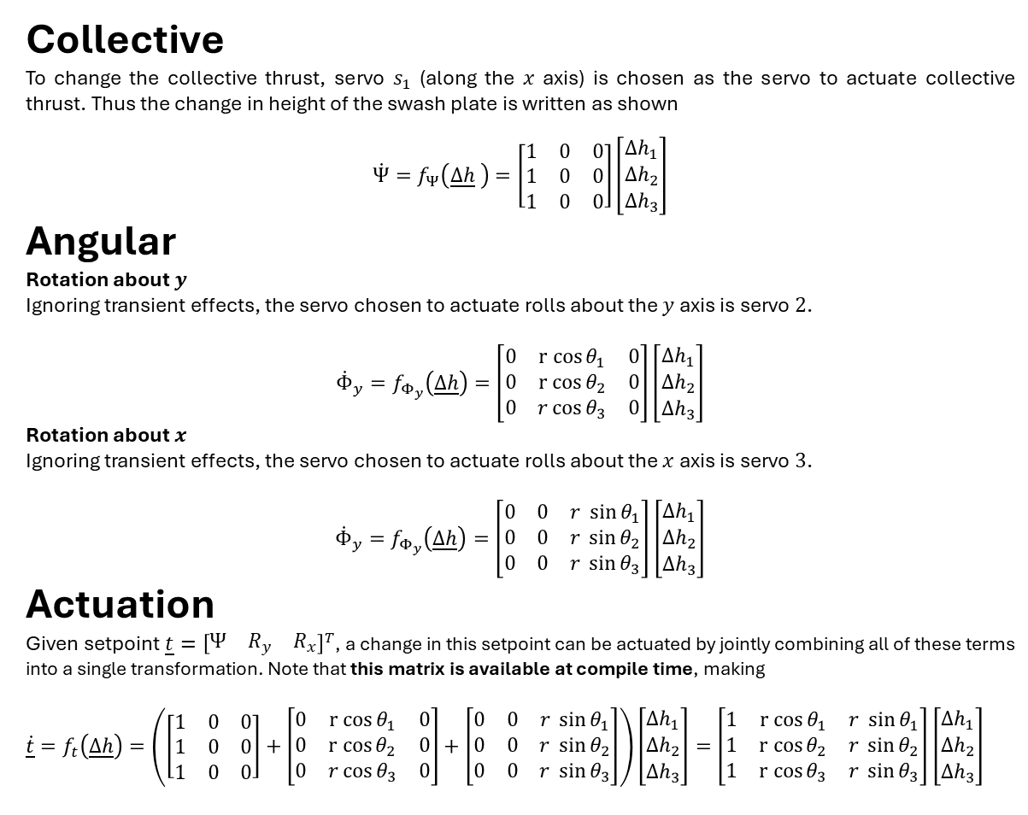
Swash Plate Feedbacks
State Space Model
$$y$$
7/11
$$p_{2}$$
$$z$$
Collective
To change the collective thrust, servo $s_{1}$ (along the $x$ axis) is chosen as the servo to actuate collective thrust. Thus the change in height of the swash plate is written as shown
$$\dot{Ψ}=f_{Ψ}\left(\underline{Δh} \right)=\left[\begin{matrix}1 & 0 & 0 \\ 1 & 0 & 0 \\ 1 & 0 & 0\end{matrix}\right]\left[\begin{matrix}{Δh}_{1} \\ {Δh}_{2} \\ {Δh}_{3}\end{matrix}\right]$$
Angular
Rotation about $y$
Ignoring transient effects, the servo chosen to actuate rolls about the $y$ axis is servo $2$.
$${\dot{Φ}}_{y}=f_{Φ_{y}}\left(\underline{Δh}\right)=\left[\begin{matrix}0 & r cos{θ_{1}} & 0 \\ 0 & r cos{θ_{2}} & 0 \\ 0 & r\cos{θ_{3}} & 0\end{matrix}\right]\left[\begin{matrix}Δh_{1} \\ Δh_{2} \\ Δh_{3}\end{matrix}\right]$$
Rotation about $x$
Ignoring transient effects, the servo chosen to actuate rolls about the $x$ axis is servo $3$.
$${\dot{Φ}}_{y}=f_{Φ_{y}}\left(\underline{Δh}\right)=\left[\begin{matrix}0 & 0 & r \sin{θ_{1}} \\ 0 & 0 & r \sin{θ_{2}} \\ 0 & 0 & r \sin{θ_{3}}\end{matrix}\right]\left[\begin{matrix}Δh_{1} \\ Δh_{2} \\ Δh_{3}\end{matrix}\right]$$
Actuation
Given setpoint $\underline{t}={\left[\begin{matrix}Ψ & R_{y} & R_{x}\end{matrix}\right]}^{T}$, a change in this setpoint can be actuated by jointly combining all of these terms into a single transformation. Note that this matrix is available at compile time, making
$\dot{\underline{t}}=f_{t}\left(\underline{Δh}\right)=\left(\left[\begin{matrix}1 & 0 & 0 \\ 1 & 0 & 0 \\ 1 & 0 & 0\end{matrix}\right]+\left[\begin{matrix}0 & r cos{θ_{1}} & 0 \\ 0 & r cos{θ_{2}} & 0 \\ 0 & r\cos{θ_{3}} & 0\end{matrix}\right]+\left[\begin{matrix}0 & 0 & r \sin{θ_{1}} \\ 0 & 0 & r \sin{θ_{2}} \\ 0 & 0 & r \sin{θ_{3}}\end{matrix}\right]\right)\left[\begin{matrix}Δh_{1} \\ Δh_{2} \\ Δh_{3}\end{matrix}\right]=\left[\begin{matrix}1 & r cos{θ_{1}} & r \sin{θ_{1}} \\ 1 & r cos{θ_{2}} & r \sin{θ_{2}} \\ 1 & r cos{θ_{3}} & r \sin{θ_{3}}\end{matrix}\right]$ $\left[\begin{matrix}Δh_{1} \\ Δh_{2} \\ Δh_{3}\end{matrix}\right]$
r
$$θ_{3}$$
$$θ_{2}$$
r
$$θ_{1}=0$$
$$x$$
$$F_{1}$$
$$p_{1}$$
r
$$p_{3}$$
$$y$$
$$j$$
$$p_{1}$$
$$Δh_{2}$$
$$F_{1}$$
r
$$Δh_{1}$$
r
$$i$$
$$p_{2}$$
$$Φ_{y}$$
$$x$$
r
$$Δh_{3}$$
$$p_{3}$$
$$k$$
Fix, output of this (I don’t think) is in the form psi dot, ry dot, rx dot
$$z$$

Slide 14







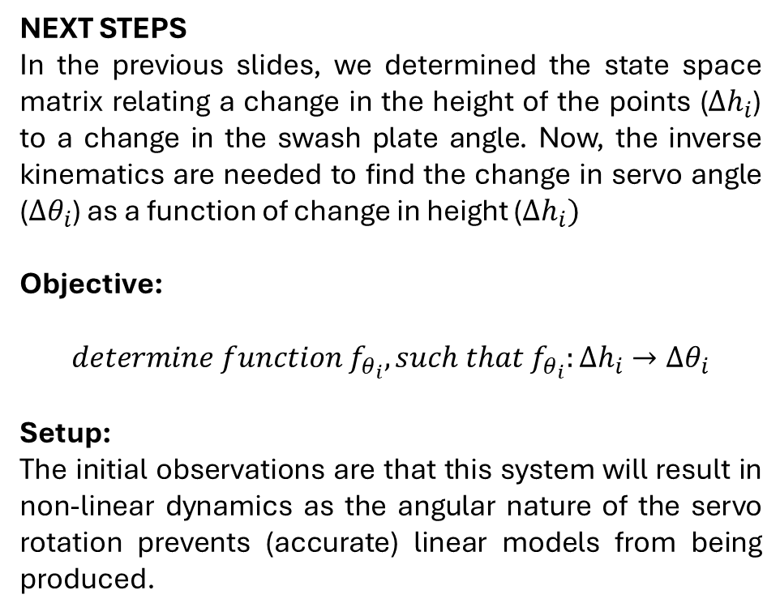






Swash Plate Dynamics
Motivation
$$a$$
$$b$$
8/11
NEXT STEPS
In the previous slides, we determined the state space matrix relating a change in the height of the points ($Δh_{i}$) to a change in the swash plate angle. Now, the inverse kinematics are needed to find the change in servo angle (${Δθ}_{i}$) as a function of change in height ($Δh_{i})$
Objective:
$$determine function f_{θ_{i}}, such that f_{θ_{i}}:Δh_{i}→Δθ_{i}$$
Setup:
The initial observations are that this system will result in non-linear dynamics as the angular nature of the servo rotation prevents (accurate) linear models from being produced.
$$s_{i}$$
$$F_{2} Plane$$
$$θ_{i}$$
$$r_{s}$$
$$r_{p}$$
$$Neutral Plane$$
$$Δh_{i}$$
$$p_{i}$$
$$l_{1}$$
$$l_{2}$$
$$l_{3}$$

Slide 15
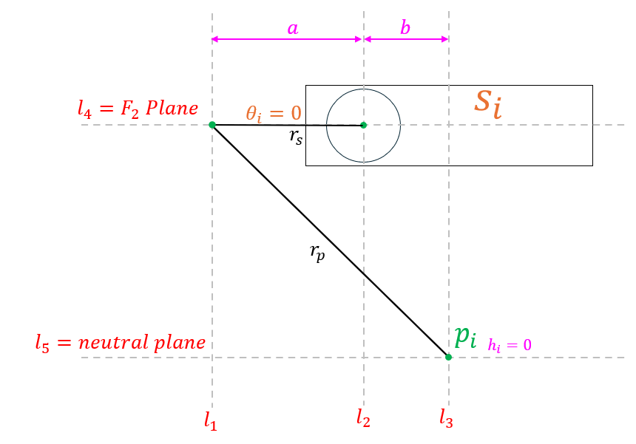
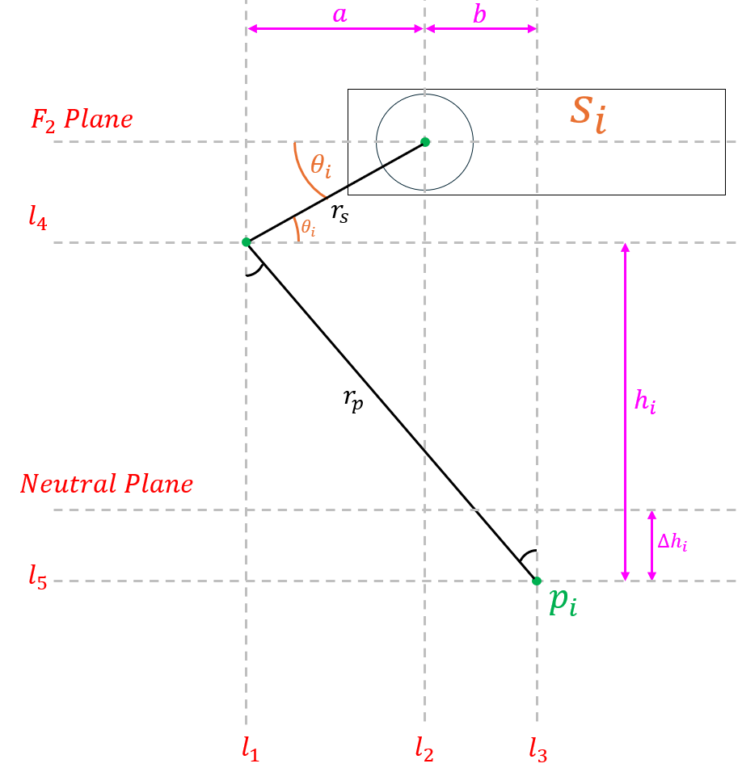
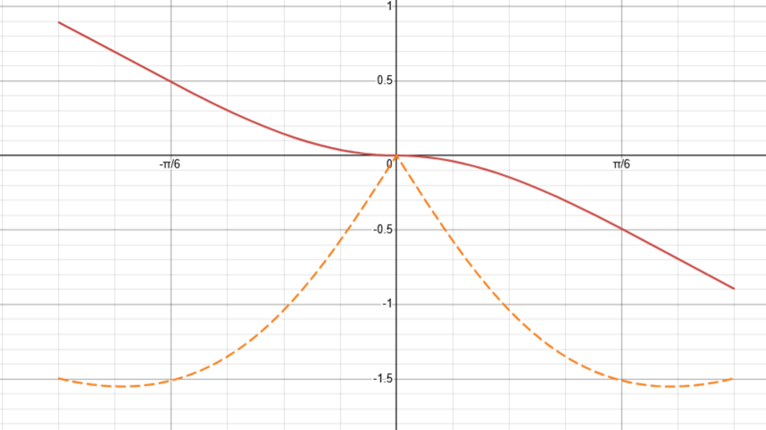
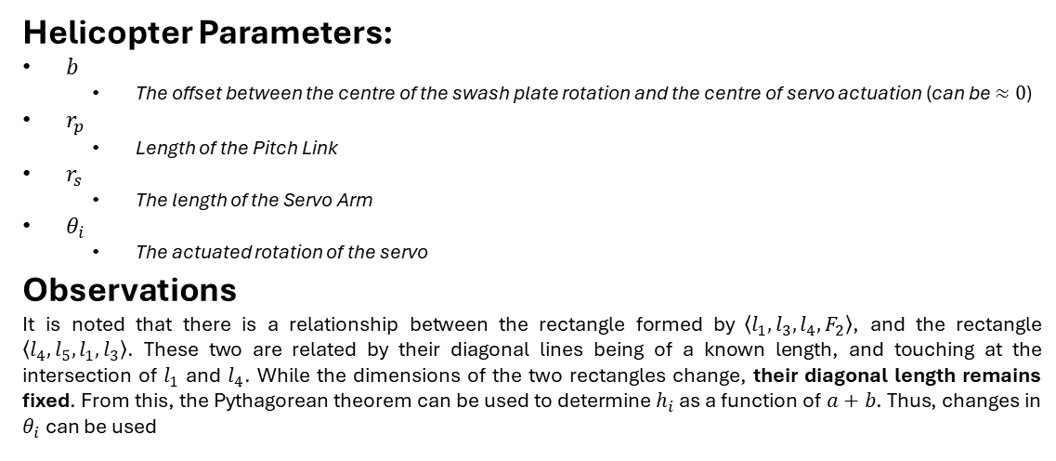
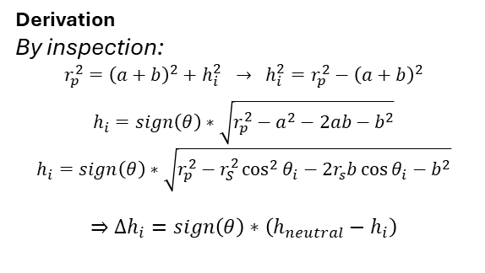
Swash Plate Dynamics
Forward Kinematics
9/11
Helicopter Parameters:
$b$
The offset between the centre of the swash plate rotation and the centre of servo actuation (can be $≈0$)
$r_{p}$
Length of the Pitch Link
$r_{s}$
The length of the Servo Arm
$θ_{i}$
The actuated rotation of the servo
Observations
It is noted that there is a relationship between the rectangle formed by $\left\langle l_{1},l_{3}, l_{4}, F_{2}\right\rangle$, and the rectangle $\left\langle l_{4},l_{5},l_{1},l_{3}\right\rangle$. These two are related by their diagonal lines being of a known length, and touching at the intersection of $l_{1}$ and $l_{4}$. While the dimensions of the two rectangles change, their diagonal length remains fixed. From this, the Pythagorean theorem can be used to determine $h_{i}$ as a function of $a+b$. Thus, changes in $θ_{i}$ can be used
Before Actuation
After Actuation
Derivation
By inspection:
$$r_{p}^{2}={\left(a+b\right)}^{2}+h_{i}^{2} → h_{i}^{2}=r_{p}^{2}−{\left(a+b\right)}^{2}$$
$$h_{i}=sign\left(θ\right)∗\sqrt{r_{p}^{2}−a^{2}−2ab−b^{2}}$$
$$h_{i}=sign\left(θ\right)∗\sqrt{r_{p}^{2}−r_{S}^{2}\cos^{2}{θ_{i}}−2r_{s}b\cos{θ_{i}−b^{2}}}$$
$$⇒Δh_{i}=sign\left(θ\right)∗\left(h_{neutral}−h_{i}\right)$$
Swash Plate Connection Point Change in Height, $Δh_{i}$ (cm) Versus Actuation Angle of Servo (radians) with a Range of $±45°$

Slide 16






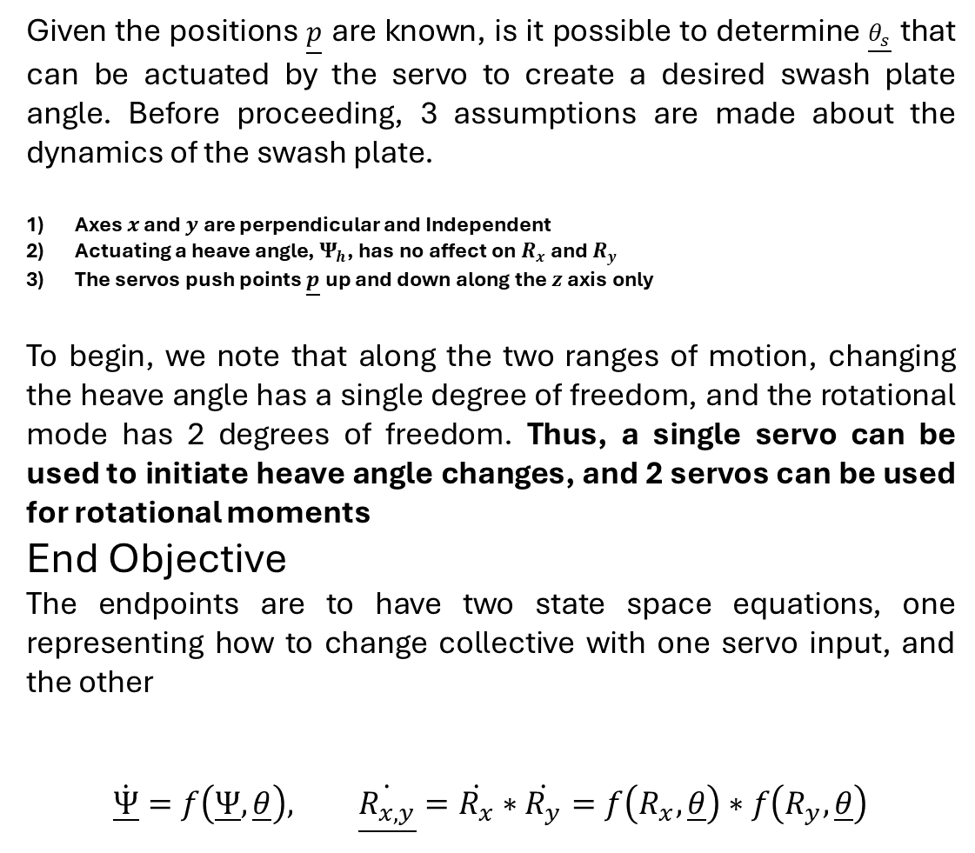














Swash Plate Dynamics
Inverse Kinematics
$$j$$
$$y$$
10/11
$${θ_{s}}_{2}$$
$${θ_{s}}_{1}$$
$$s_{2}$$
Given the positions $\underline{p}$ are known, is it possible to determine $\underline{θ_{s}}$ that can be actuated by the servo to create a desired swash plate angle. Before proceeding, 3 assumptions are made about the dynamics of the swash plate.
Axes $x$ and $y$ are perpendicular and Independent
Actuating a heave angle, $Ψ_{h}$, has no affect on $R_{x}$ and $R_{y}$
The servos push points $\underline{p}$ up and down along the $z$ axis only
To begin, we note that along the two ranges of motion, changing the heave angle has a single degree of freedom, and the rotational mode has 2 degrees of freedom. Thus, a single servo can be used to initiate heave angle changes, and 2 servos can be used for rotational moments
End Objective
The endpoints are to have two state space equations, one representing how to change collective with one servo input, and the other
$$\dot{\underline{Ψ}}=f\left(\underline{Ψ},\underline{θ}\right), \underline{\dot{R_{x,y}}}=\dot{R_{x}}∗\dot{R_{y}}=f\left(R_{x}, \underline{θ}\right)∗f\left(R_{y}, \underline{θ}\right)$$
$$s_{1}$$
$$i$$
$$x$$
$$s_{3}$$
$$F_{2}$$
$${θ_{s}}_{3}$$
$$j$$
$$y$$
$$p_{1}$$
$$Δh_{2}$$
r
$$Δh_{1}$$
r
$$i$$
$$p_{2}$$
$$Φ_{y}$$
$$x$$
$$F_{1}$$
r
$$Δh_{3}$$
$$y$$
$$j$$
$$p_{3}$$
Heave angle = $Ψ$
$$i$$
$$x$$
$$F_{0}$$
$$k$$
$$z$$

Slide 17
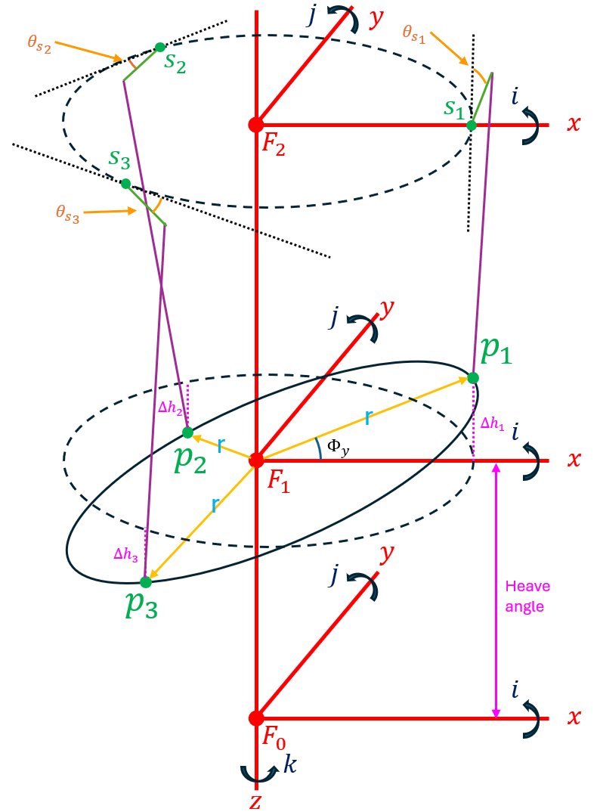
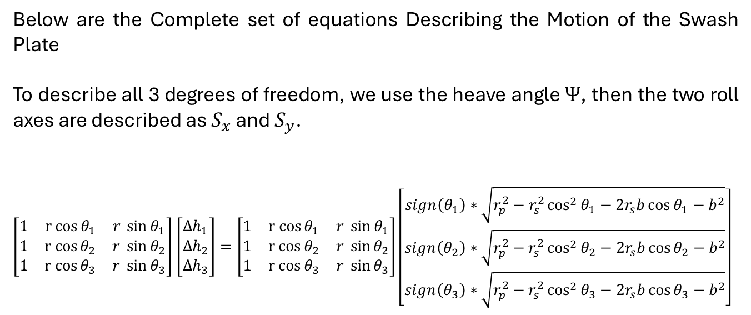
Swash Plate Dynamics
Putting Everything Together
11/11
Below are the Complete set of equations Describing the Motion of the Swash Plate
To describe all 3 degrees of freedom, we use the heave angle $Ψ$, then the two roll axes are described as $S_{x}$ and $S_{y}$.
$\left[\begin{matrix}1 & r cos{θ_{1}} & r \sin{θ_{1}} \\ 1 & r cos{θ_{2}} & r \sin{θ_{2}} \\ 1 & r cos{θ_{3}} & r \sin{θ_{3}}\end{matrix}\right]$ $\left[\begin{matrix}Δh_{1} \\ Δh_{2} \\ Δh_{3}\end{matrix}\right]=\left[\begin{matrix}1 & r cos{θ_{1}} & r \sin{θ_{1}} \\ 1 & r cos{θ_{2}} & r \sin{θ_{2}} \\ 1 & r cos{θ_{3}} & r \sin{θ_{3}}\end{matrix}\right]\left[\begin{matrix}sign\left(θ_{1}\right)∗\sqrt{r_{p}^{2}−r_{s}^{2}\cos^{2}{θ_{1}}−2r_{s}b\cos{θ_{1}−b^{2}}} \\ sign\left(θ_{2}\right)∗\sqrt{r_{p}^{2}−r_{s}^{2}\cos^{2}{θ_{2}}−2r_{s}b\cos{θ_{2}−b^{2}}} \\ sign\left(θ_{3}\right)∗\sqrt{r_{p}^{2}−r_{s}^{2}\cos^{2}{θ_{3}}−2r_{s}b\cos{θ_{3}−b^{2}}}\end{matrix}\right]$

Slide 18


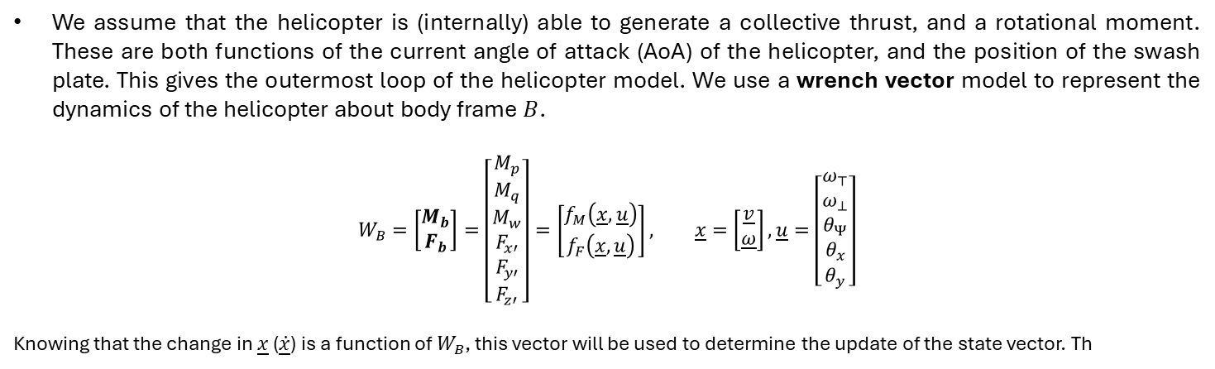





Helicopter Model Plan
$$O_{1}$$
We assume that the helicopter is (internally) able to generate a collective thrust, and a rotational moment. These are both functions of the current angle of attack (AoA) of the helicopter, and the position of the swash plate. This gives the outermost loop of the helicopter model. We use a wrench vector model to represent the dynamics of the helicopter about body frame $B$.
$$W_{B}=\left[\begin{matrix}M_{b} \\ F_{b}\end{matrix}\right]=\left[\begin{matrix}M_{p} \\ M_{q} \\ M_{w} \\ F_{x′} \\ F_{y′} \\ F_{z′}\end{matrix}\right]=\left[\begin{matrix}f_{M}\left(\underline{x}, \underline{u}\right) \\ f_{F}\left(\underline{x},\underline{u}\right)\end{matrix}\right], \underline{x}=\left[\begin{matrix}\underline{v} \\ \underline{ω}\end{matrix}\right], \underline{u}=\left[\begin{matrix}ω_{⊤} \\ ω_{⊥} \\ θ_{Ψ} \\ θ_{x} \\ θ_{y}\end{matrix}\right]$$
Knowing that the change in $\underline{x}$ ($\underline{\dot{x}}$) is a function of $W_{B}$, this vector will be used to determine the update of the state vector. Th
$$p$$
$$x′$$
$$q$$
$$y′$$
$$w$$
$$z′$$

Slide 19
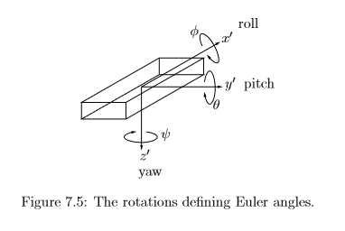
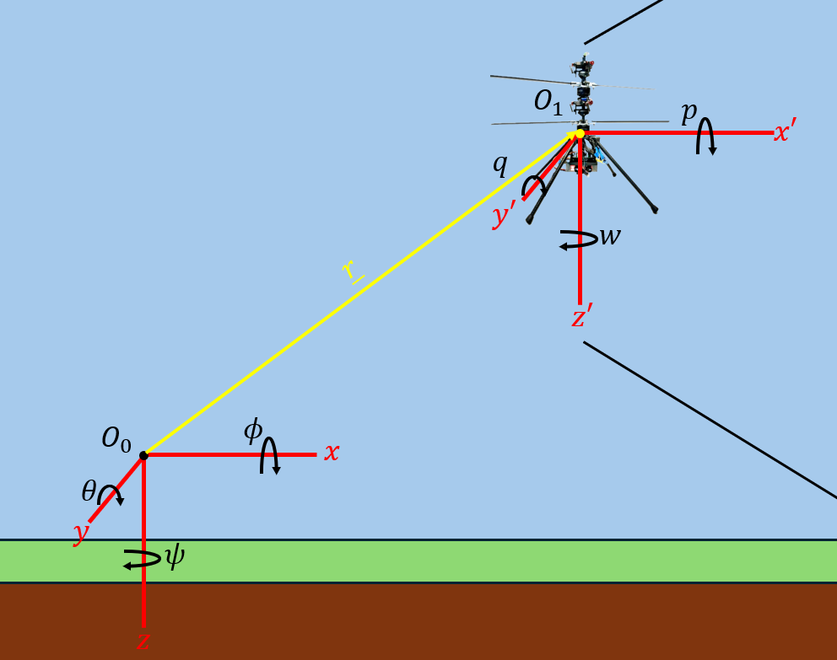
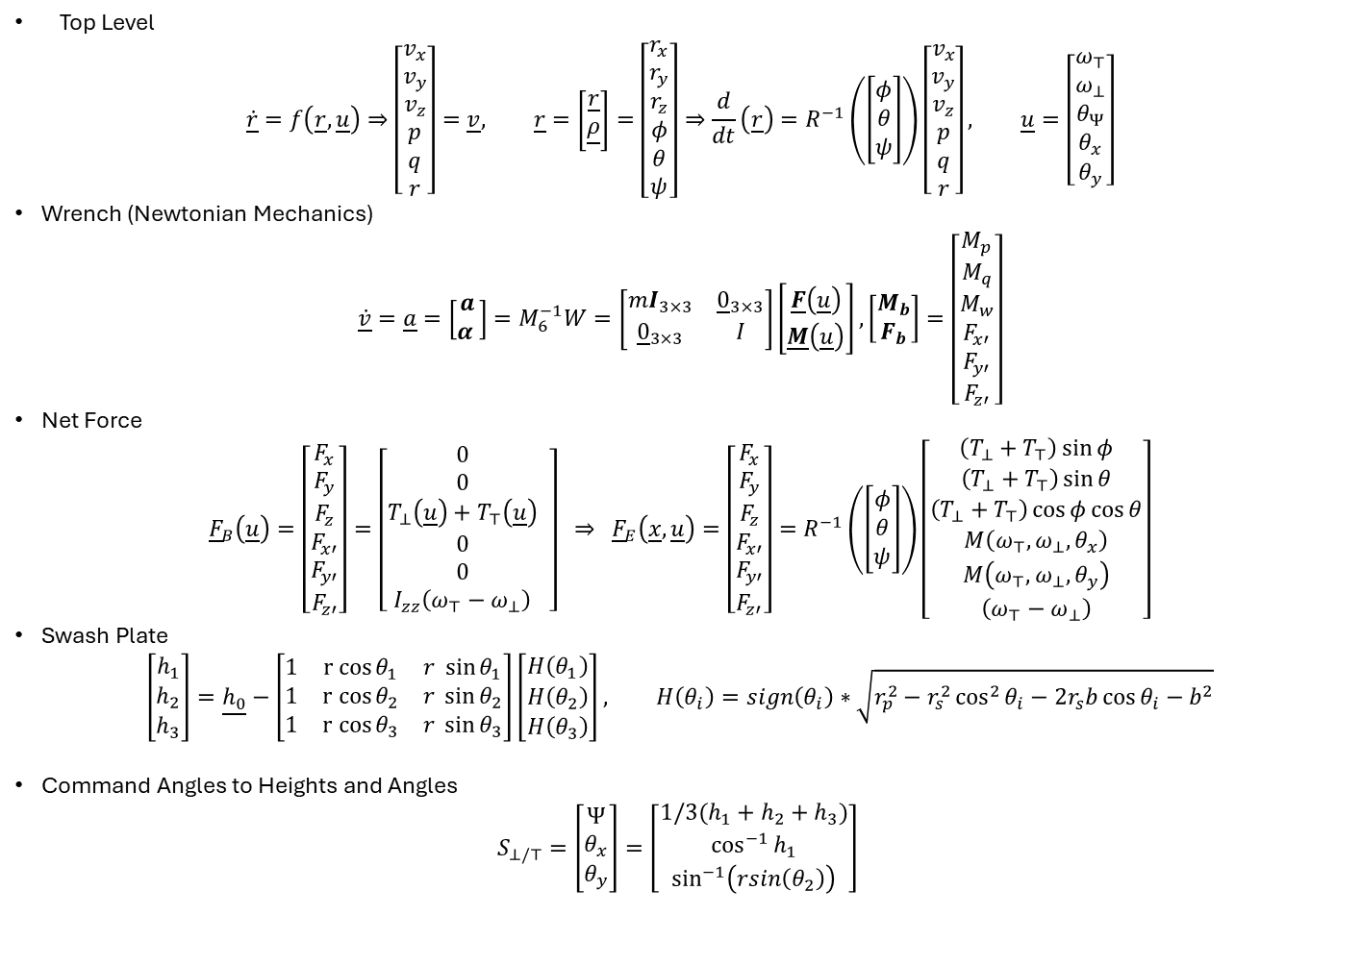
Equations of Motion
Earth frame
Body Frame (can you do this?)
Top Level
$$\dot{\underline{r}}=f\left(\underline{r},\underline{u}\right)⇒\left[\begin{matrix}v_{x} \\ v_{y} \\ v_{z} \\ p \\ q \\ r\end{matrix}\right]=\underline{v}, \underline{r}=\left[\begin{matrix}\underline{r} \\ \underline{ρ}\end{matrix}\right]=\left[\begin{matrix}r_{x} \\ r_{y} \\ r_{z} \\ φ \\ θ \\ ψ\end{matrix}\right]⇒\frac{d}{dt}\left(\underline{r}\right)=R^{−1}\left(\left[\begin{matrix}φ \\ θ \\ ψ\end{matrix}\right]\right)\left[\begin{matrix}v_{x} \\ v_{y} \\ v_{z} \\ p \\ q \\ r\end{matrix}\right], \underline{u}=\left[\begin{matrix}ω_{⊤} \\ ω_{⊥} \\ θ_{Ψ} \\ θ_{x} \\ θ_{y}\end{matrix}\right]$$
Wrench (Newtonian Mechanics)
$$\dot{\underline{v}}=\underline{a}=\left[\begin{matrix}a \\ α \end{matrix}\right]=M_{6}^{−1}W=\left[\begin{matrix}mI_{3×3} & {\underline{0}}_{3×3} \\ {\underline{0}}_{3×3} & I\end{matrix}\right]\left[\begin{matrix}\underline{F}\left(\underline{u}\right) \\ \underline{M}\left(\underline{u}\right)\end{matrix}\right],\left[\begin{matrix}M_{b} \\ F_{b}\end{matrix}\right]=\left[\begin{matrix}M_{p} \\ M_{q} \\ M_{w} \\ F_{x′} \\ F_{y′} \\ F_{z′}\end{matrix}\right]$$
Net Force
$${\underline{F}}_{B}\left(\underline{u}\right)=\left[\begin{matrix}F_{x} \\ F_{y} \\ F_{z} \\ F_{x′} \\ F_{y′} \\ F_{z′}\end{matrix}\right]=\left[\begin{matrix}0 \\ 0 \\ T_{⊥}\left(\underline{u}\right)+T_{⊤}\left(\underline{u}\right) \\ 0 \\ 0 \\ I_{zz}\left(ω_{⊤}−ω_{⊥}\right)\end{matrix} \right] ⇒ {\underline{F}}_{E}\left(\underline{x},\underline{u}\right)=\left[\begin{matrix}F_{x} \\ F_{y} \\ F_{z} \\ F_{x′} \\ F_{y′} \\ F_{z′}\end{matrix}\right]=R^{−1}\left(\left[\begin{matrix}φ \\ θ \\ ψ\end{matrix}\right]\right)\left[\begin{matrix}\left(T_{⊥}+T_{⊤}\right)\sin{φ} \\ \left(T_{⊥}+T_{⊤}\right)\sin{θ} \\ \left(T_{⊥}+T_{⊤}\right)\cos{φ}\cos{θ} \\ M\left(ω_{⊤},ω_{⊥},θ_{x}\right) \\ M\left(ω_{⊤},ω_{⊥},θ_{y}\right) \\ \left(ω_{⊤}−ω_{⊥}\right)\end{matrix}\right]$$
Swash Plate
$$\left[\begin{matrix}h_{1} \\ h_{2} \\ h_{3}\end{matrix}\right]=\underline{h_{0}}−\left[\begin{matrix}1 & r cos{θ_{1}} & r \sin{θ_{1}} \\ 1 & r cos{θ_{2}} & r \sin{θ_{2}} \\ 1 & r cos{θ_{3}} & r \sin{θ_{3}}\end{matrix}\right]\left[\begin{matrix}H\left(θ_{1}\right) \\ H\left(θ_{2}\right) \\ H\left(θ_{3}\right)\end{matrix}\right], H\left(θ_{i}\right)=sign\left(θ_{i}\right)∗\sqrt{r_{p}^{2}−r_{s}^{2}\cos^{2}{θ_{i}}−2r_{s}b\cos{θ_{i}−b^{2}}}$$
Command Angles to Heights and Angles
$$S_{⊥/⊤}=\left[\begin{matrix}Ψ \\ θ_{x} \\ θ_{y}\end{matrix}\right]=\left[\begin{matrix}{1/3(h}_{1}+h_{2}+h_{3}) \\ \cos^{−1}{h_{1}} \\ \sin^{−1}\left(rsin\left(θ_{2}\right)\right)\end{matrix}\right]$$
$$O_{1}$$
$$p$$
$$x′$$
$$q$$
Identity
$$y′$$
$$w$$
Body Frame
Earth Frame
Inertia
$$z′$$
Functions T and M are going to be found from Literature, they represent the collective thrust generated, and the angular moments about each axis

Slide 20
Equations of Motion, Nomenclature
$$O_{1}$$
$T_{⊥},T^{⊤}$, Thrust from the bottom and top rotors (gives the magnitude along the $z’$ direction)
$$p$$
$$x′$$
$$q$$
$$y′$$
$$w$$
$$z′$$

Slide 21
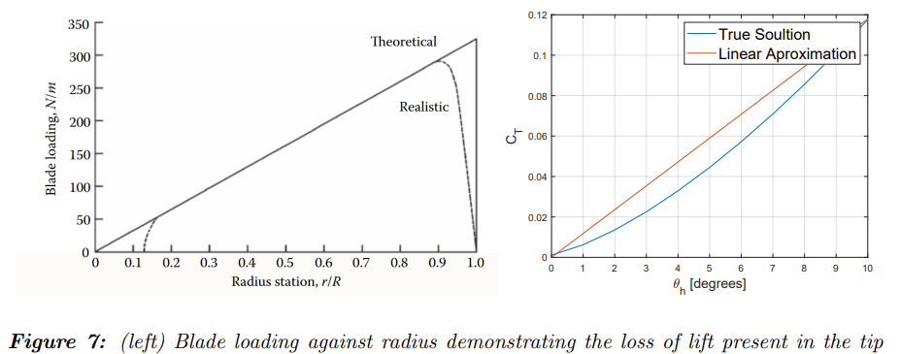
Thrust Profiles

Slide 22

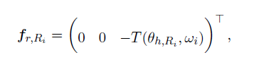
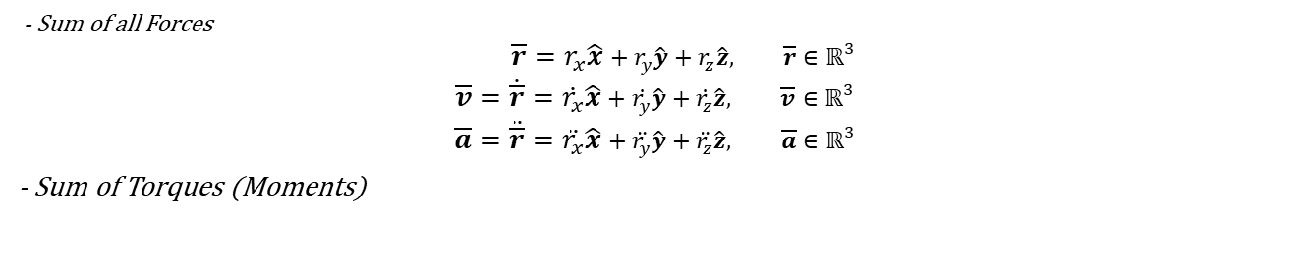
Sum of Forces
- Sum of all Forces
$$\overline{r}=r_{x}\hat{x}+r_{y}\hat{y}+r_{z}\hat{z}, \overline{r}∈ℝ^{3}$$
$$\overline{v}=\dot{\overline{r}}=\dot{r_{x}}\hat{x}+\dot{r_{y}}\hat{y}+\dot{r_{z}}\hat{z}, \overline{v}∈ℝ^{3}$$
$$\overline{a}=\ddot{\overline{r}}=\ddot{r_{x}}\hat{x}+\ddot{r_{y}}\hat{y}+\ddot{r_{z}}\hat{z}, \overline{a}∈ℝ^{3}$$
- Sum of Torques (Moments)

Slide 23
Christmas Planning

Slide 24
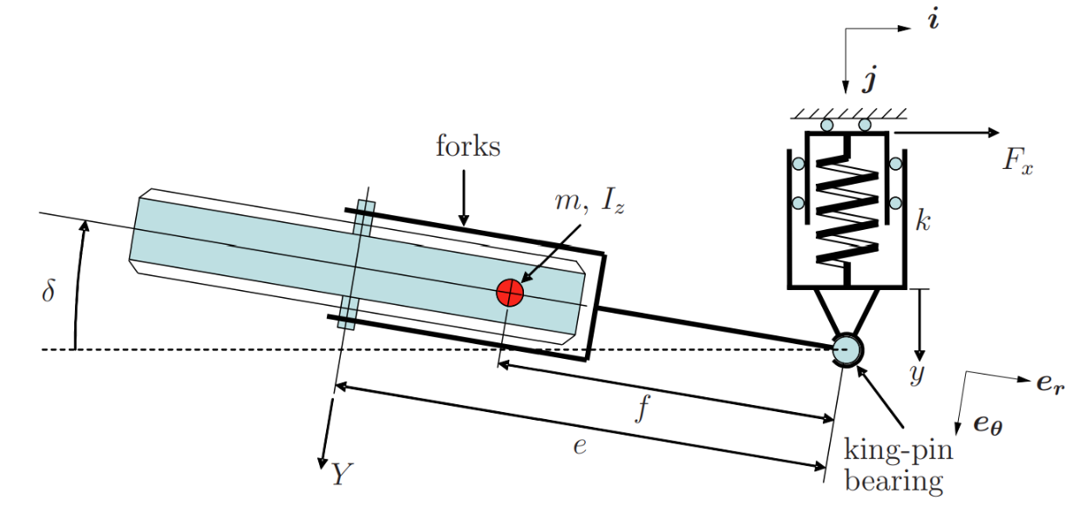
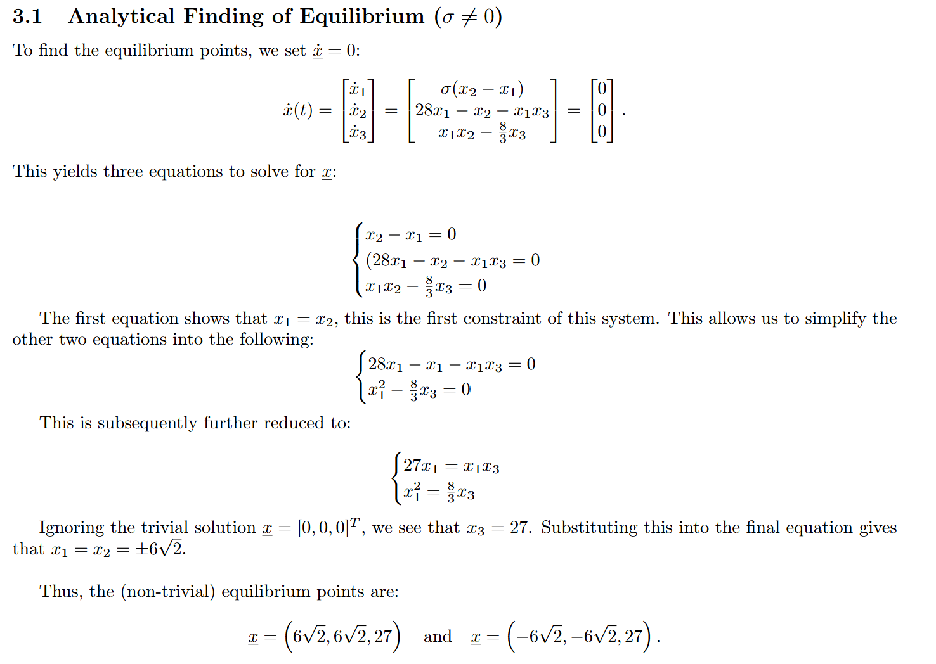
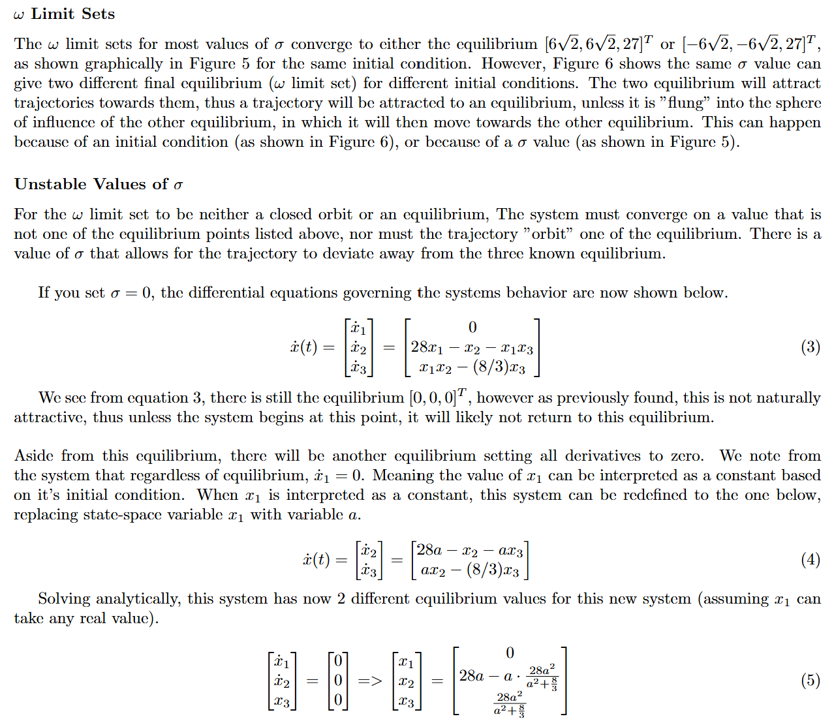
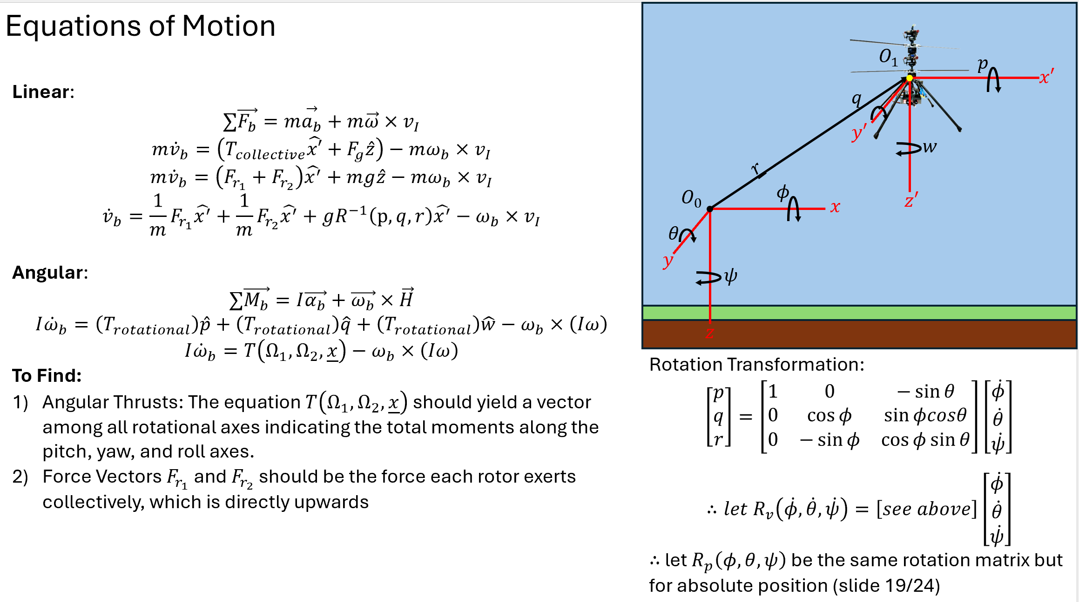
Project Tasks
0) Familiarization
Literature Exploration
Mechanical Systems Coursework
Non-Linear Control Coursework 1
Non-Linear Control Coursework 2
Practice Questions
System Characterization
Equations of Motion
Swash Plate Mechanics
Blade Characterization
Software Model
Helicopter Model
Linear Dynamics
Rotational Dynamics
Swashplate Dynamics
Blade flap dynamics
IO test (verification it works)
Controller Design
Lyupanov Functions
Theoretical Control Model
Deployed Hardware-ready Controller
Software Testing and Validation
Testing and Data Collection
To be determined

Slide 25
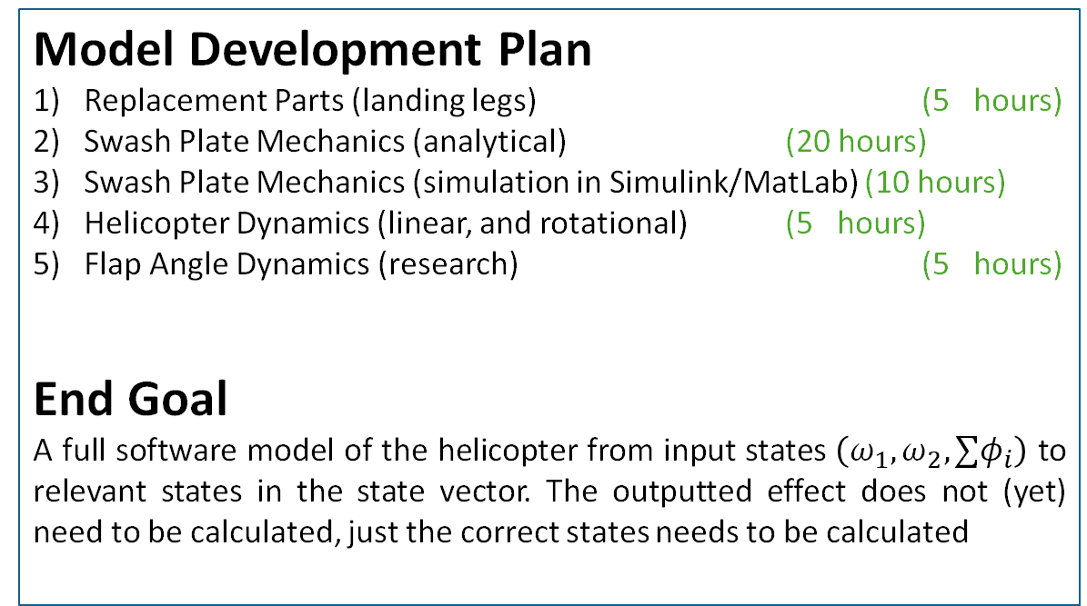
Winter Plan
Model Development Plan
Replacement Parts (landing legs) (5 hours)
Swash Plate Mechanics (analytical) (20 hours)
Swash Plate Mechanics (simulation in Simulink/MatLab) (10 hours)
Helicopter Dynamics (linear, and rotational) (5 hours)
Flap Angle Dynamics (research) (5 hours)
End Goal
A full software model of the helicopter from input states $\left(ω_{1},ω_{2},{∑φ}_{i}\right)$ to relevant states in the state vector. The outputted effect does not (yet) need to be calculated, just the correct states needs to be calculated
0) Familiarization
Literature Exploration
Mechanical Systems Coursework
Non-Linear Control Coursework 1
Non-Linear Control Coursework 2
Practice Questions
System Characterization
Equations of Motion
Swash Plate Mechanics
Blade Characterization
Software Model
Helicopter Model
Translational Dynamics
Rotational Dynamics
Swashplate Dynamics
Blade flap dynamics
IO test (verification it works)
Controller Design
Lyupanov Functions
Theoretical Control Model
Deployed Hardware-ready Controller
Software Testing and Validation
Testing and Data Collection
To be determined
2025

Slide 26
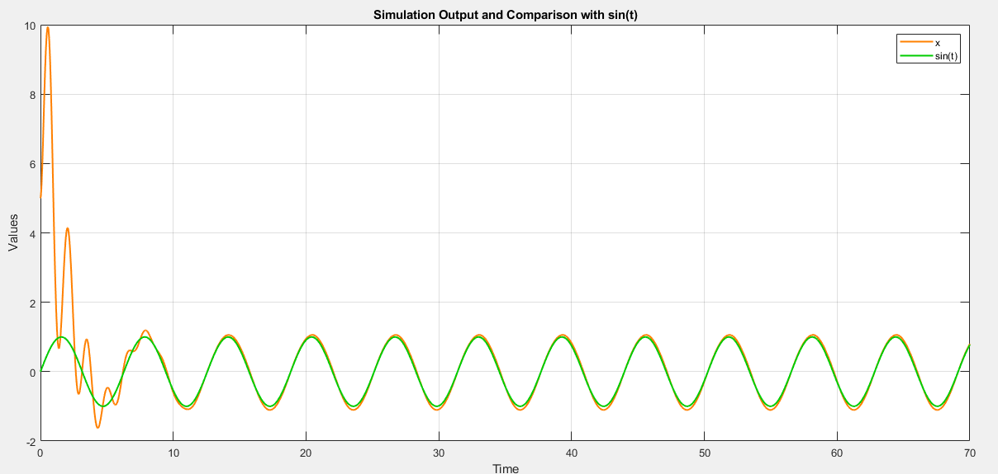
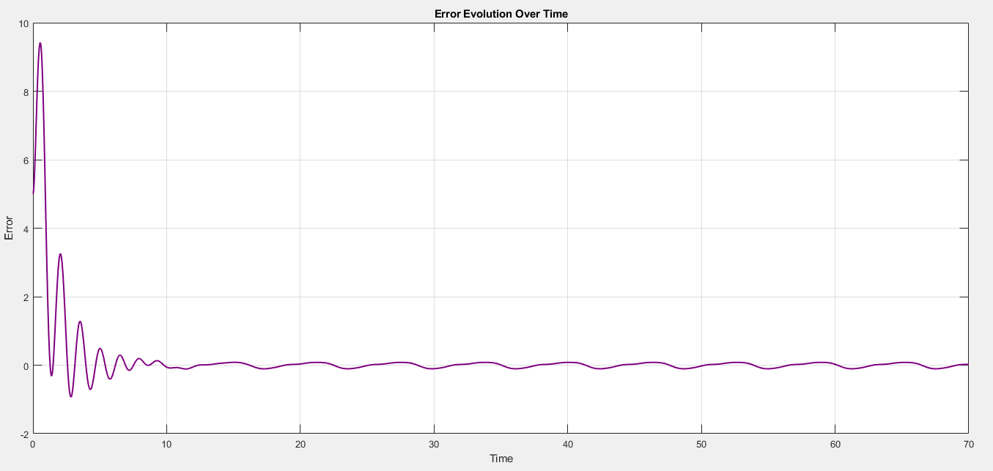

Practice Question
$$\ddot{x}=x\sin{x}, setpoint:r\left(t\right)=\sin{t}$$
Define State Variables and Setpoint State
$$\underline{x}=\left[\begin{matrix}x \\ \dot{x}\end{matrix}\right]⇒\dot{\underline{x}}=\left[\begin{matrix}\dot{x} \\ \ddot{x}\end{matrix}\right]=\left[\begin{matrix}\dot{x} \\ x\sin{x}\end{matrix}\right], \underline{r}=\left[\begin{matrix}r \\ \dot{r}\end{matrix}\right]=\left[\begin{matrix}\sin{t} \\ \cos{t}\end{matrix}\right]$$
Create Feedback System
$$\dot{\underline{x}}=f\left(x,u\right)=\left[\begin{matrix}\dot{x} \\ x\sin{x}\end{matrix}\right]+\left[\begin{matrix}0 \\ 2\end{matrix}\right]u\left(t\right)$$
Establish error functions
$$\underline{e}=\underline{r}−\underline{x}=\left[\begin{matrix}\sin{t} \\ \cos{t}\end{matrix}\right]−\left[\begin{matrix}x \\ \dot{x}\end{matrix}\right]⇒\dot{\underline{e}}=\left[\begin{matrix}\dot{r} \\ \ddot{r}\end{matrix}\right]−\left[\begin{matrix}\dot{x} \\ \ddot{x}\end{matrix}\right]=\left[\begin{matrix}\cos{t}−\dot{x} \\ −sin{t−x\sin{x}}\end{matrix}\right]$$
Set Input as a function of the state and the error
$$\dot{\underline{x}}=\left[\begin{matrix}\dot{x} \\ x\sin{x}\end{matrix}\right]+\left[\begin{matrix}0 & 0 \\ 0 & 2\end{matrix}\right]u\left(t\right)=\left[\begin{matrix}\dot{x} \\ x\sin{x}\end{matrix}\right]+\left[\begin{matrix}0 & 0 \\ 0 & 2\end{matrix}\right]\left(A\underline{x}+B\underline{e}\right)$$
Generalize to Parameters to Optimise
$$\underline{\dot{x}}=\left[\begin{matrix}\dot{x} \\ x\sin{x}\end{matrix}\right]+\left[\begin{matrix}0 & 0 \\ 0 & 2\end{matrix}\right]\left(\left[\begin{matrix}a_{1} & a_{2} \\ a_{3} & a_{4}\end{matrix}\right]\left[\begin{matrix}\dot{x} \\ x\sin{x}\end{matrix}\right]+\left[\begin{matrix}b_{1} & b_{2} \\ b_{3} & b_{4}\end{matrix}\right]\left[\begin{matrix}e \\ \dot{e}\end{matrix}\right]\right)$$
Expanding:
$$\underline{\dot{x}}=\left[\begin{matrix}\dot{x} \\ \ddot{x}\end{matrix}\right]=\left[\begin{matrix}\dot{x} \\ x\sin{x}\end{matrix}\right]+\left[\begin{matrix}0 \\ 2a_{3}\dot{x}+2a_{4}x\sin{x}+2b_{3}e+2b_{4}\dot{e}\end{matrix}\right]$$
Set $a_{3}=0$, $a_{4}=−0.5$ (cancel out existing dynamics), then use $b_{3}$ and $b_{4}$ as correction terms which are functions of the direct error and the “velocity” of the error
First Attempt
CONSIDER R DOUBLE DOT HERE
ADD R TO EACH SIDE SO IS A FUNCTION OF ERROR

Slide 27
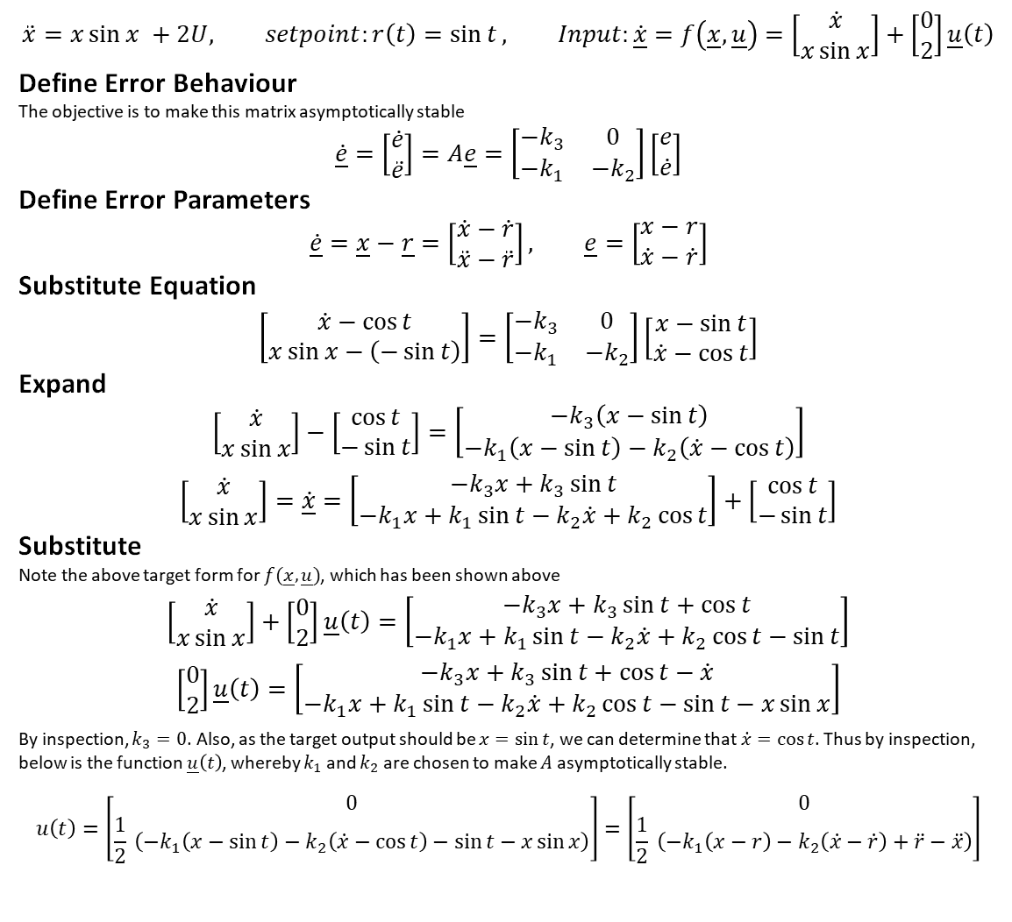
Practice Question
$$\ddot{x}=x\sin{x }+2U, setpoint:r\left(t\right)=\sin{t}, Input:\dot{\underline{x}}=f\left(\underline{x},\underline{u}\right)=\left[\begin{matrix}\dot{x} \\ x\sin{x}\end{matrix}\right]+\left[\begin{matrix}0 \\ 2\end{matrix}\right]\underline{u}\left(t\right)$$
Define Error Behaviour
The objective is to make this matrix asymptotically stable
$$\underline{\dot{e}}=\left[\begin{matrix}\dot{e} \\ \ddot{e}\end{matrix}\right]=A\underline{e}=\left[\begin{matrix}−k_{3} & 0 \\ −k_{1} & −k_{2}\end{matrix}\right]\left[\begin{matrix}e \\ \dot{e}\end{matrix}\right]$$
Define Error Parameters
$$\dot{\underline{e}}=\underline{x}−\underline{r}=\left[\begin{matrix}\dot{x}−\dot{r} \\ \ddot{x}−\ddot{r}\end{matrix}\right], \underline{e}=\left[\begin{matrix}x−r \\ \dot{x}−\dot{r}\end{matrix}\right]$$
Substitute Equation
$$\left[\begin{matrix}\dot{x}−\cos{t} \\ x\sin{x}−\left(−\sin{t}\right)\end{matrix}\right]=\left[\begin{matrix}−k_{3} & 0 \\ −k_{1} & −k_{2}\end{matrix}\right]\left[\begin{matrix}x−\sin{t} \\ \dot{x}−\cos{t}\end{matrix}\right]$$
Expand
$$\left[\begin{matrix}\dot{x} \\ x\sin{x}\end{matrix}\right]−\left[\begin{matrix}\cos{t} \\ −\sin{t}\end{matrix}\right]=\left[\begin{matrix}−k_{3}\left(x−\sin{t}\right) \\ −k_{1}\left(x−\sin{t}\right)−k_{2}\left(\dot{x}−\cos{t}\right)\end{matrix}\right]$$
$$\left[\begin{matrix}\dot{x} \\ x\sin{x}\end{matrix}\right]=\dot{\underline{x}}=\left[\begin{matrix}−k_{3}x+k_{3}\sin{t} \\ −k_{1}x+k_{1}\sin{t}−k_{2}\dot{x}+k_{2}\cos{t}\end{matrix}\right]+\left[\begin{matrix}\cos{t} \\ −\sin{t}\end{matrix}\right]$$
Substitute
Note the above target form for $f(\underline{x},\underline{u})$, which has been shown above
$$\left[\begin{matrix}\dot{x} \\ x\sin{x}\end{matrix}\right]+\left[\begin{matrix}0 \\ 2\end{matrix}\right]\underline{u}\left(t\right)=\left[\begin{matrix}−k_{3}x+k_{3}\sin{t}+\cos{t} \\ −k_{1}x+k_{1}\sin{t}−k_{2}\dot{x}+k_{2}\cos{t}−\sin{t}\end{matrix}\right]$$
$$\left[\begin{matrix}0 \\ 2\end{matrix}\right]\underline{u}\left(t\right)=\left[\begin{matrix}−k_{3}x+k_{3}\sin{t}+\cos{t}−\dot{x} \\ −k_{1}x+k_{1}\sin{t}−k_{2}\dot{x}+k_{2}\cos{t}−\sin{t}−x\sin{x}\end{matrix}\right]$$
By inspection, $k_{3}=0$. Also, as the target output should be $x=\sin{t}$, we can determine that $\dot{x}=\cos{t}$. Thus by inspection, below is the function $\underline{u}\left(t\right)$, whereby $k_{1}$ and $k_{2}$ are chosen to make $A$ asymptotically stable.
$$u\left(t\right)=\left[\begin{matrix}0 \\ \frac{1}{2} \left(−k_{1}\left(x−\sin{t}\right)−k_{2}\left(\dot{x}−\cos{t}\right)−\sin{t}−x\sin{x}\right)\end{matrix}\right]=\left[\begin{matrix}0 \\ \frac{1}{2} \left(−k_{1}\left(x−r\right)−k_{2}\left(\dot{x}−\dot{r}\right)+\ddot{r}−\ddot{x}\right)\end{matrix}\right]$$
DO NOT USE X DOUBLE DOT, U CANNOT BE A FUNCTION OF X DOUBLE DOT BECAUSE THEN YOU ARE
IGNORE, DO NOT WRITE X DOUBLE DOT BECAUSE YOU CANNOT USE X DOUBLE DOT IN THE FUNTION
X SIN X IS A FUNCTION, NOT X DOUBLE DOT

Slide 28
Initial Brainstorm for Model Constraints
Swash Plates | Helicopter
- Simulink Model using Laplacian (analytical) constraint equations - Direct 1:1 functional mapping (is a ridged body, so can expect it to be “directly controlled”). Servos/swash plate are also fixed relative to the body frame - Assumed the servos have no error, and any error in the servos will be compensated by an actuation in the opposite direction - Non linear model to accommodate for the angular rotation of each pitch link-servo pair | - 2 Models with inner/outer loop configuration - Outer Model: Translational Motion and Rotational Motion (represented by a COM point, and a pitch/yaw/roll configuration) - Inner Model: Helicopter internal dynamics including swash plates, blade flap, and rotational velocities. This model will output the net torque, and net (collective) thrust impacting the helicopter. The Outer model will then execute (integrate) these net forces and alter the - Build in features to introduce errors, and see how the MatLab model reacts to induced errors

Slide 29
End of Christmas Planning

Slide 30
Winter Term Planning

Slide 31
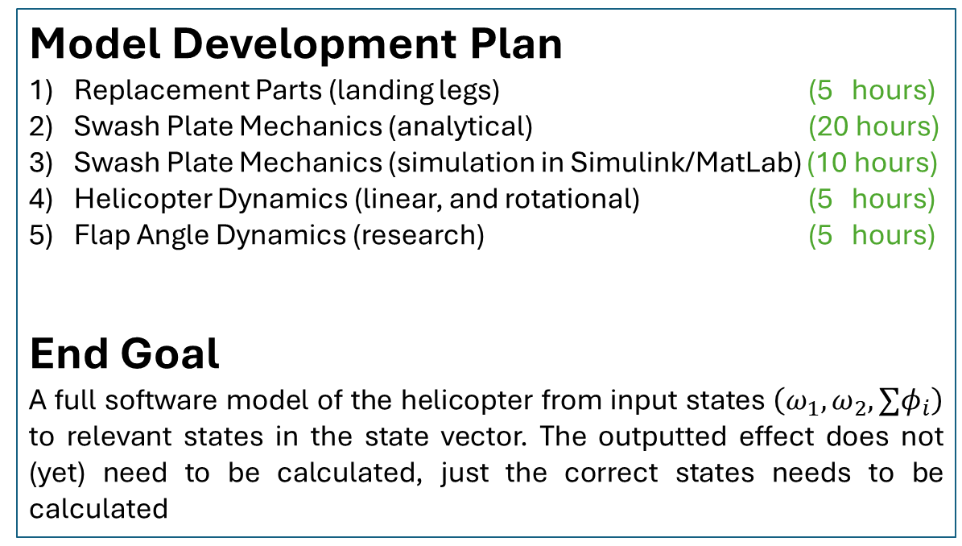
Winter Term Plan
Model Development Plan
Replacement Parts (landing legs) (5 hours)
Swash Plate Mechanics (analytical) (20 hours)
Swash Plate Mechanics (simulation in Simulink/MatLab) (10 hours)
Helicopter Dynamics (linear, and rotational) (5 hours)
Flap Angle Dynamics (research) (5 hours)
End Goal
A full software model of the helicopter from input states $\left(ω_{1},ω_{2},{∑φ}_{i}\right)$ to relevant states in the state vector. The outputted effect does not (yet) need to be calculated, just the correct states needs to be calculated
0) Familiarization
Literature Exploration
Mechanical Systems Coursework
Non-Linear Control Coursework 1
Non-Linear Control Coursework 2
Practice Questions
System Characterization
Equations of Motion
Swash Plate Mechanics
Blade Characterization
Software Model
Helicopter Model
Translational Dynamics
Rotational Dynamics
Swashplate Dynamics
Blade flap dynamics
IO test (verification it works)
Controller Design
Lyapunov Functions
Theoretical Control Model
Deployed Hardware-ready Controller
Software Testing and Validation
Testing and Data Collection
To be determined
Summer 2025

Slide 32
End of Winter Term Planning

Slide 34
Rotor
(Two linked Blades)
Servo
Rotation-Locking Fork
Upper Rotor
Servo Arm
Motor
Lower Rotor
Blade
Pitch Link
Connection Point
Swash Plate
Blade Holder(s)
Battery
Landing Leg(s)
shaft

Slide 35
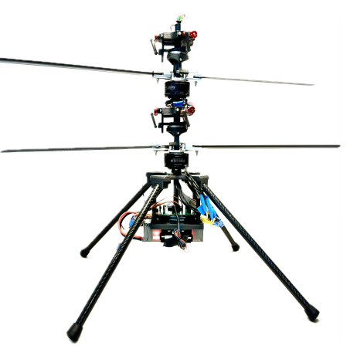

$$y$$
$$p_{2}$$
$$F_{1}$$
$$x$$
$$p_{1}$$
$$p_{2}$$
$$z$$

Slide 36
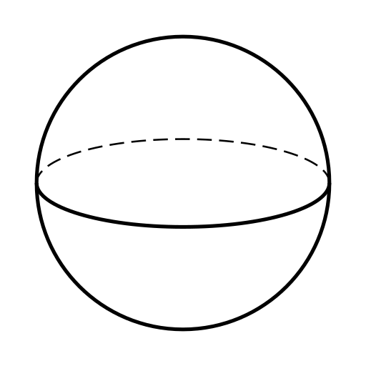
r
r
r

Slide 37












































$$j$$
$$y$$
$${θ_{s}}_{2}$$
$${θ_{s}}_{1}$$
$$a$$
$$b$$
$$s_{2}$$
$$s_{1}$$
$$i$$
$$s_{i}$$
$$x$$
$$s_{3}$$
$$F_{2}$$
$$F_{2} Plane$$
$$θ_{i}$$
$${θ_{s}}_{3}$$
$$r_{s}$$
$$l_{4}$$
$$θ_{i}$$
$$j$$
$$y$$
$$p_{1}$$
$$Δh_{2}$$
r
$$Δh_{1}$$
$$r_{p}$$
$$h_{i}$$
r
$$i$$
$$p_{2}$$
$$Φ_{y}$$
$$x$$
$$F_{1}$$
r
$$Neutral Plane$$
$$Δh_{3}$$
$$y$$
$${Δh}_{i}$$
$$j$$
$$p_{3}$$
Heave angle
$$l_{5}$$
$$p_{i}$$
$$i$$
$$x$$
$$F_{0}$$
$$k$$
$$l_{1}$$
$$l_{2}$$
$$l_{3}$$
$$z$$

Slide 38













$$a$$
$$b$$
$$s_{i}$$
$${l_{4}=F}_{2} Plane$$
$$θ_{i}=0$$
$$r_{s}$$
$$r_{p}$$
$$p_{i}$$
$$l_{5}=neutral plane$$
$$h_{i}=0$$
$$l_{1}$$
$$l_{2}$$
$$l_{3}$$

Slide 39










$$a$$
$$b$$
3/4
$$s_{i}$$
$$F_{2} Plane$$
$$θ_{i}$$
$$r_{s}$$
$$r_{p}$$
$$p_{i}$$
$$Ψ_{h}+Δh_{i}$$
$$F_{0} Plane$$
$$l_{1}$$
$$l_{2}$$
$$l_{3}$$

Slide 41









Swash Plate Dynamics
Forward Kinematics
$$a$$
$$b$$
3/4
Helicopter Parameters:
$b$
The offset between the centre of the swash plate rotation and the centre of servo actuation (can be $≈0$)
$r_{p}$
Length of the Pitch Link
$r_{s}$
The length of the Servo Arm
$θ_{i}$
The actuated rotation of the servo
Derivation
To begin, we note that $l_{1}$ will always be parallel to $l_{3}$, and they will both be perpendicular to $l_{4}$ and $l_{5}$.
$$h_{i}=h_{1}+h_{2}$$
$$h_{i}=r_{s}\sin{θ_{i}}+\sqrt{r_{p}^{2}+{\left(b+r_{s}\cos{θ_{i}}\right)}^{2}}$$
$$\frac{dh_{i}}{dθ}=r_{s}\cos{θ_{i}}+\frac{2b+2r_{s}\cos{θ_{i}}−r_{s}\sin{θ_{i}}}{{\left(r_{p}^{2}+{\left(b+r_{s}\cos{θ_{i}}\right)}^{2}\right)}^{1/2}}$$
This solution as of right now is known to be quite inefficient, despite being correct. There will be some further exploration especially regarding some other observations, such as maybe assuming that the area of the lower triangle stays constant, and thus a differential equation can be constructed rather than an analytical solution
$$s_{i}$$
$$F_{2} Plane$$
$$θ_{i}$$
$$h_{1}$$
$$r_{s}$$
$$l_{4}$$
$$θ_{i}$$
$$r_{p}$$
$$h_{i}$$
$$h_{2}$$
$$l_{5}$$
$$p_{i}$$
$$b+a=b+r_{s}\cos{θ_{i}}$$
$$l_{1}$$
$$l_{2}$$
$$l_{3}$$

Slide 42
Swash Plate Dynamics
Inverse Kinematics
$$j$$
$$y$$
5/4
$${θ_{s}}_{2}$$
$${θ_{s}}_{1}$$
$$s_{2}$$
Given the positions $\underline{p}$ are known, is it possible to determine $\underline{θ_{s}}$ that can be actuated by the servo to create a desired swash plate angle. Before proceeding, 3 assumptions are made about the dynamics of the swash plate.
Axes $x$ and $y$ are perpendicular and Independent
Actuating a heave angle, $Ψ_{h}$, has no affect on $R_{x}$ and $R_{y}$
The servos push points $\underline{p}$ up and down along the $z$ axis only
To begin, we note that along the two ranges of motion, changing the heave angle has a single degree of freedom, and the rotational mode has 2 degrees of freedom. Thus, a single servo can be used to initiate heave angle changes, and 2 servos can be used for rotational moments
End Objective
The endpoints are to have two state space equations, one representing how to change collective with one servo input, and the other
$$\dot{\underline{Ψ}}=f\left(\underline{Ψ},\underline{θ}\right), \underline{\dot{R_{x,y}}}=\dot{R_{x}}∗\dot{R_{y}}=f\left(R_{x}, \underline{θ}\right)∗f\left(R_{y}, \underline{θ}\right)$$
$$s_{1}$$
$$i$$
$$x$$
$$s_{3}$$
$$F_{2}$$
$${θ_{s}}_{3}$$
$$j$$
$$y$$
$$p_{1}$$
$$Δh_{2}$$
r
$$Δh_{1}$$
r
$$i$$
$$p_{2}$$
$$Φ_{y}$$
$$x$$
$$F_{1}$$
r
$$Δh_{3}$$
$$y$$
$$j$$
$$p_{3}$$
Heave angle = $Ψ$
$$i$$
$$x$$
$$F_{0}$$
$$k$$
$$z$$

